Slide 1
November 2019
Chicago, IL
Bangalore, India
www.mu-sigma.com
Vaccines Promotional Response Modeling
Mu Sigma’s Proposal to Fortune 500 Healthcare Company

Slide 2
Executive Summary
Solution Design
Who we are
Engagement & Governance Model
Timelines and Cost
Experience in Promotional Response Modeling and Sales Force Effectiveness
AGENDA

Slide 3
Executive Summary
Solution Design
Who we are
Engagement & Governance Model
Timelines and Cost
Experience in Promotional Response Modeling and Sales Force Effectiveness
AGENDA

Slide 4
Executive Summary
Our understanding of your need
You are looking to develop best-in-class sustainable promotional response modeling methodology to feed into your end-to-end sales force targeting strategy for VS and KAM Sales Teams for up to 8 brands
Why Mu Sigma?
Mu Sigma has partnered with ~140 Fortune 500 customers to help them transform decision sciences. Many of these engagements include solving similar problems to measure response to promotions and designing a winning sales force strategy. We have included examples of such engagements in this document
We offer a white box approach - the final solution built by Mu Sigma will be owned by you
We offer flexibility and agility to scale and staff the team with the right skills according to the changing needs. This is accomplished through our ecosystem of people, process, platforms
We have developed thorough understanding of the your ecosystem through our 8+ years of partnership across various groups in the US
What are we proposing?
We will adopt a 5 step solution approach:
SEGMENTATION - Brand level account segmentation through Exploratory analysis followed by experimentation with multiple segmentation models
PROMOTIONAL RESPONSE MODELING - Brand-segment level response curves through rapid simulations enabled by using pre-built reusable Mu Sigma accelerators
SIZING SIMULATION - Sizing scenarios based on brand-segment level response curves and brand team inputs for KAM, VS teams through IROI based optimization by iterating through multiple business scenarios
ALIGNMENT DESIGN - Optimal territory alignment for KAM & VS sales teams through evaluation across four dimensions of workload, travel efficiency, sales potential and disruption
PEOPLE PLACEMENT - Best People Placement Recommendation through evaluation between placement optimization and best-fit approach based on business requirements and exploratory analysis
Timelines and Cost
Mu Sigma will complete the project before July 31, 2020
Mu Sigma has come up with a detailed, cost proposal for the project, which also factors in for discounts. The detailed breakup can be found here

Slide 5
Our understanding of the scope of the RFP
Objective:
By July 30th, 2020, you want to Optimize sales force headcount across the VS and KAM sales teams and complete the people placement process
This optimization should enable achievement of sales objectives at lower than current cost of managing sales force
This solution to achieve the above sales force optimization should be based on proven scientific techniques built on advances in Machine Learning
The solutions should provide multiple scenarios (5/6) for head count spend, product mix and its impact on revenue
Market/Geography in scope: US
8 Brands (2 are yet to be launched) are in scope for the above:
Brand 1
Brand 2
Brand 3
Brand 4
Brand 5
Brand 6
Brand 7 (launch 2020)
Brand 8 (launch 2021)
Data to be used:
Account level Vaccine Sales by brand
Internal Calls Data, Employee Rosters, Previous zip-terr alignment
Final deliverables:
New account segmentation
Promotional Response Curves for all brand-segment combinations
Different scenarios for Sales force sizing (across VS & KAM teams) and corresponding impact on sales/profits
Finalized territory alignments across VS and KAM sales teams
People placement recommendations for both sales force teams
Algorithms we will use: We will experiment with ~20 different modeling techniques including (but not limited to) Bayesian Hierarchical Models, Hungarian algorithms, Structural Equation Models
Mode of delivery:
Jupyter notebooks for all reusable components delivered to you
PowerPoint presentations for sharing results

Slide 6
Executive Summary
Solution Design
Who we are
Engagement & Governance Model
Timelines and Cost
Experience in Promotional Response Modeling and Sales Force Effectiveness
AGENDA

Slide 7

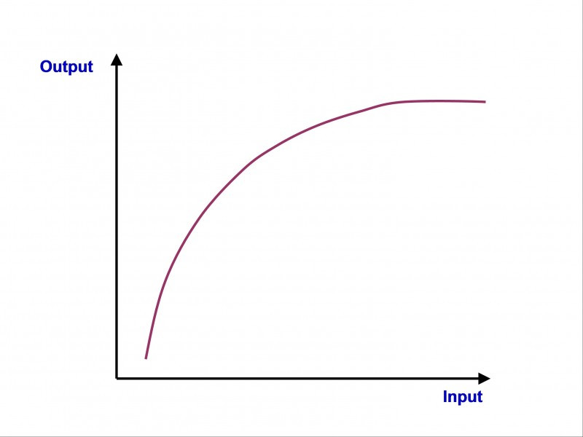



Solution Approach – 5 step process
While delivering immediate value, Mu Sigma will help you build long-term capability through advanced analytics in areas of promotional response modeling and sales force effectiveness
PROMOTIONAL RESPONSE MODELING
ALIGNMENT DESIGN
01
Brand-segment level response curves
Approach – Rapid simulations enabled by using pre-built reusable Mu Sigma accelerators
03
Optimal territory alignment for KAM & VS sales teams
Approach – Evaluation across four dimensions of workload, travel efficiency, sales potential and disruption
05
SEGMENTATION
Sizing simulation
PEOPLE PLACEMENT
Brand level account segmentation
Approach – Thorough Exploratory analysis followed by experimentation with multiple segmentation models
02
Sizing scenarios based on brand-segment level response curves and brand team inputs for KAM, VS teams
Approach – IROI based optimization by iterating through multiple business scenarios
04
Best People Placement Recommendation
Approach – Evaluate between placement optimization and best-fit approach based on business requirements and exploratory analysis

Slide 8
Requirement to Solution Mapping
RFP Ask | Mapping to Mu Sigma’s 5 step process
Data collection, organization, segmentation and modelling - Conversation with 5 brand teams to decide segmentation variables to support Promotion Response Modeling (PRM) for up to 8 brands - Process internal call/sales data to generate the final database for modelling - Response curves for 8 brands | Segmentation, Promotional Response Modeling
Creation of multiple scenarios of size and (potentially) product placement for your two (VS and KAM) sales forces. We may require 5-6 sales force scenarios - Optimization of new scenarios. - Calculation of projected revenue from multiple scenarios (reflecting alternatives of targeting and sales force size and structure) - Reporting on all results | Sizing Simulation
Collect the business rules and parameters that will be feed into alignment design process - Finalization on Input datasets – Roster, Previous ZIP-Terr, Vaccines sales - Recommend metrics to create alignment Index | Alignment Design
Territory Location Analysis - Head count allocation (HCA) analysis - Impacted VS divisions should have appropriate span of control (>7 SOC) - Workload Assessment across territories | Alignment Design
Territory Design - Bottom-up approach: Review VS Sales Reps territories followed by KAM territories - ZIP based design for VS sales reps | Alignment Design
Alignment Sessions - Conduct sessions with Home office/Sales Leadership to incorporate management feedback | Alignment Design
Final Delivery/Feedback Incorporation - Deliver final alignment materials to you - Work with SFE/Field to provide recommendations to you on Alignment design | Alignment Design
People Placement - Develop rules for People Placement in consultation with business - Provide best placement | People Placement

Slide 9
Solution Approach – 5 step process
While delivering immediate value, Mu Sigma will help client build long-term capability through advanced analytics in areas of promotional response modeling and sales force effectiveness
PROMOTIONAL RESPONSE MODELING
ALIGNMENT DESIGN
01
Brand-segment level response curves
Approach – Rapid simulations enabled by using pre-built reusable Mu Sigma accelerators
03
Optimal territory alignment for KAM & VS sales teams
Approach – Evaluation across four dimensions of workload, travel efficiency, sales potential and disruption
05
SEGMENTATION
Sizing simulation
PEOPLE PLACEMENT
Brand level account segmentation
Approach – Thorough Exploratory analysis followed by experimentation with multiple segmentation models
02
Sizing scenarios based on brand-segment level response curves and brand team inputs for KAM, VS teams
Approach – IROI based optimization by iterating through multiple business scenarios
04
Best People Placement Recommendation
Approach – Evaluate between placement optimization and best-fit approach based on business requirements and exploratory analysis

Slide 10
Segmentation (1/5)
Step I: Segmentation
Effective segmentation requires thorough exploratory data analysis, experimentation with algorithmic and rule-based models, and timely business validation
Feedback
Problem formulation
Data collection & EDA*
Modeling Analysis
Validation with Business
Develop statement of objectives
Establish success criteria in muOBI format
Represent the problem using top-down and hypothesis driven approach
Acquire data and evaluate for integrity and accuracy
Formulate and finalize business rules through multiple iterations
Conduct EDA to validate business hypotheses, understand variable distributions, correlations
Explore and experiment with rule-based segments as well as algorithmic segments, or hybrid (heuristic + algorithmic) segments based on EDA results and discussion with business
Rule-based segmentation based on Sales Potential (High/Medium/Low) and Competition Dynamic (Loyal, Competitive, Mixed)
Creation of Composite segments as required such as High Sales Potential + High Loyalty, Medium Sales Potential + Competitive
Create algorithmic segments by mapping out affiliations (if required), variable definition, clustering, and profiling
Evaluate and interpret analysis results into tangible decisions
Solicit feedback from business
Develop documentation and training material (documents, walk-through videos)
Key activities
Detailed data request
Detailed project plan, timelines and deliverables
Data Quality Report
Business rules document
EDA Notebook (Jupyter) for signal classification (positive/negative) and influence of concomitants
Detailed results and findings (Jupyter)
Segment definitions – heuristic/algorithmic/hybrid as decided
Modeling results and parameters
Model comparisons
Key insights from segment profiling exercise
Brand level: segment – account mapping
QlikSense dashboard
Final presentation of the analytical reports, insights, & recommendations
Transition package including documentation, business rules, code etc.
Deliverables
*EDA – Exploratory Data Analysis

Slide 11

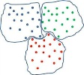
Segmentation (2/5)
Step I: Segmentation
A structured approach, including business feedback at the modeling steps, is required for effective segmentation based on advanced algorithms
Mapping out affiliations
IMS HCOS data can be used to map out HCP-Account-Corporate Parent affiliations
Variable definition & refinement
Define and refine the set of variables across:
1. Value
2. Level of Health systems integration & control
3. Behavioral variables
Clustering and Profiling
Experiment with clustering algorithms – partitional, hierarchical, hybrid
Profiling of segments based on:
1. Volume
2. Spread
3. Control
4. Payer Concentration
5. ACO affiliation
Align Segments with Business Strategy
Incorporate business inputs and feedback for segments
Utilize the segmentation output to answer key business questions
Size
Influence
Control
Feedback

Slide 12
Segmentation (3/5)
Step I: Segmentation
Asking the right questions with the objective to understand IDNs enabled us to define a set of key value & behavioral variables
Illustrative
S. No. | Questions we need to ask about the health systems… | Possible ways to find the answers…
1 | How much demand is driven? | Market/ product volume, etc.
2 | What is the spread of the Health systems and its affiliates? | # MSAs the Health system is driving demand
3 | What is the depth of the Health systems and its affiliates? | % Contribution within MSAs across its footprint
4 | What is the level of integration & control of the Health systems? | Std. deviation of market share across affiliated accounts/ HCPs
5 | What is the ability of the account to drive brand utilization? | Brand to competition ratio of the Health systems Std. deviation of brand competitor ratio among affiliated HCPs to identify the brand or competition drive of the Health systems
6 | Is the Health system oriented towards a specific insurance channel? | % Contribution across insurance channels
7 | How responsive are affiliated HCPs to client’s field promotions? | HCP promotional response curves
8 | Does the account have higher overall patient cost? | Average OOP cost of patients

Slide 13
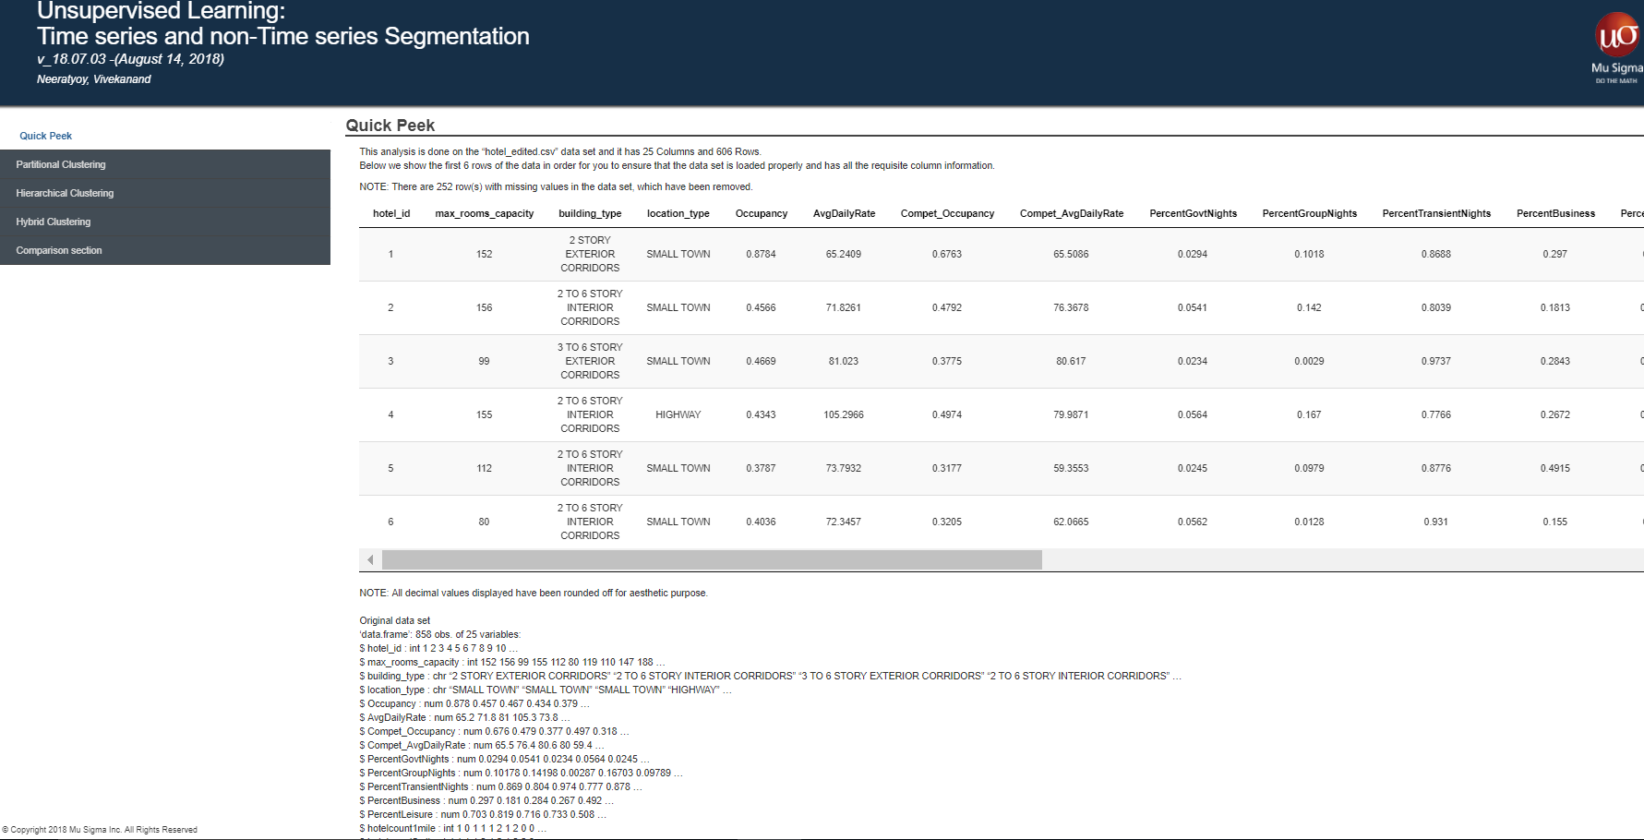
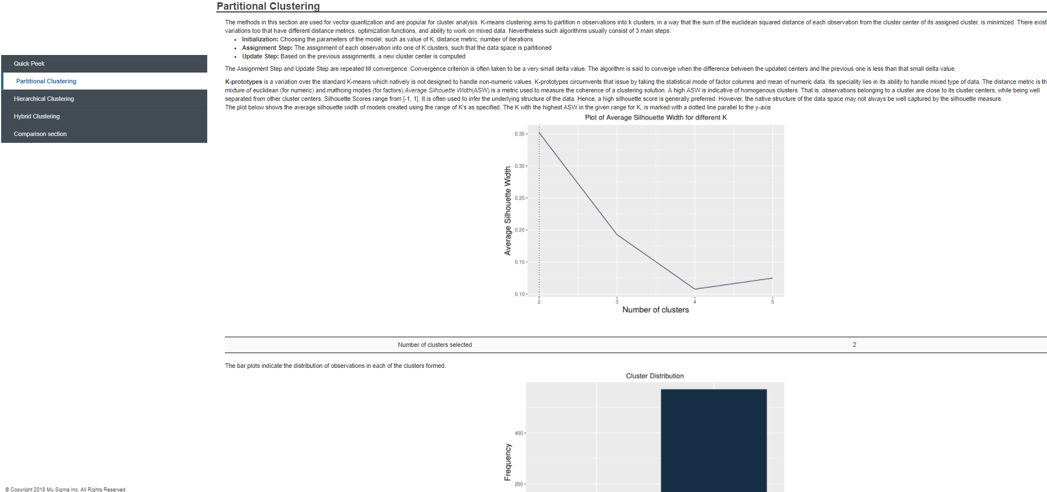
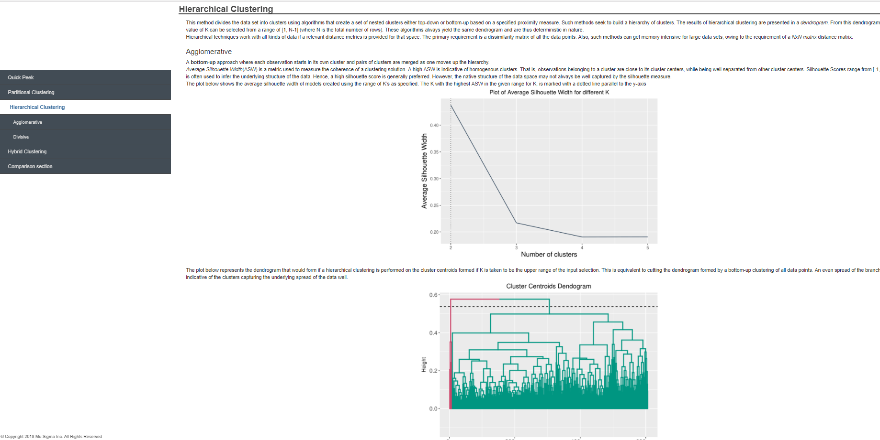
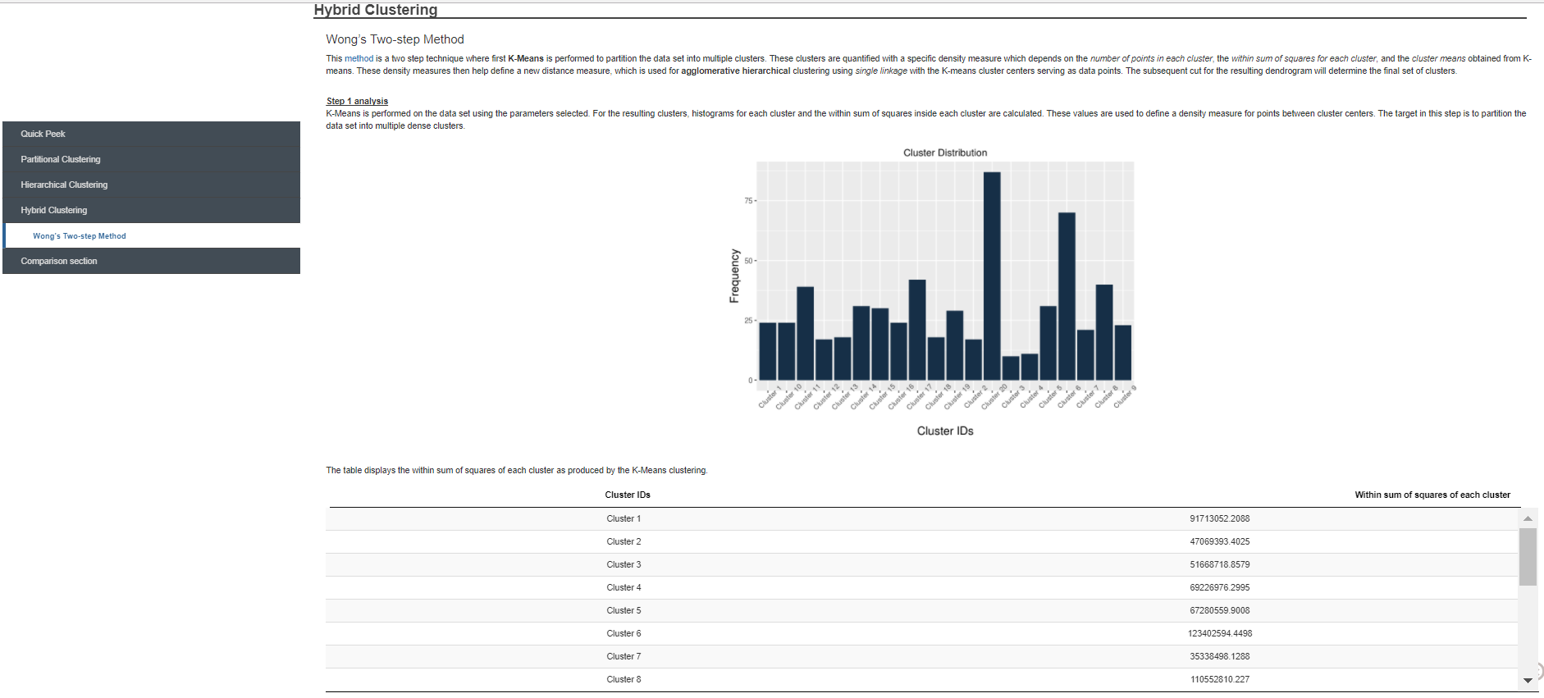
Segmentation (4/5)
Step I: Segmentation
Mu Sigma’s pre-built advanced analytics accelerators enable quick experimentation, helping stakeholders converge faster
Quick Peek - Data
Partitional Clustering
Hierarchical Clustering
Hybrid Clustering

Slide 14
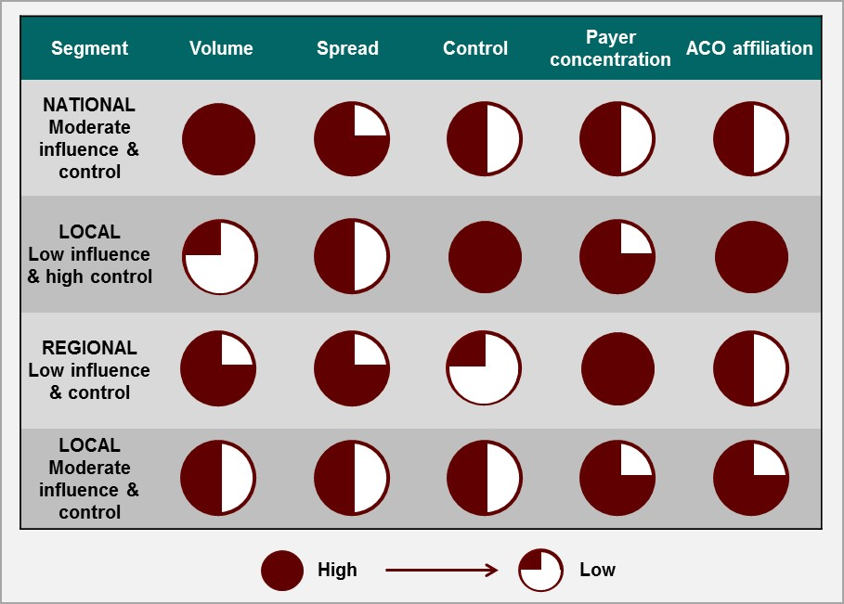
Segmentation (5/5)
Step I: Segmentation
Potential segments as a result of the segmentation exercise
Illustrative

Slide 15
Solution Approach – 5 step process
While delivering immediate value, Mu Sigma will help client build long-term capability through advanced analytics in areas of promotional response modeling and sales force effectiveness
PROMOTIONAL RESPONSE MODELING
ALIGNMENT DESIGN
01
Brand-segment level response curves
Approach – Rapid simulations enabled by using pre-built reusable Mu Sigma accelerators
03
Optimal territory alignment for KAM & VS sales teams
Approach – Evaluation across four dimensions of workload, travel efficiency, sales potential and disruption
05
SEGMENTATION
Sizing simulation
PEOPLE PLACEMENT
Brand level account segmentation
Approach – Thorough Exploratory analysis followed by experimentation with multiple segmentation models
02
Sizing scenarios based on brand-segment level response curves and brand team inputs for KAM, VS teams
Approach – IROI based optimization by iterating through multiple business scenarios
04
Best People Placement Recommendation
Approach – Evaluate between placement optimization and best-fit approach based on business requirements and exploratory analysis

Slide 16
Promotional Response modelling (1/14)
Step II: Promotional Response Modeling
Mu Sigma recommends a “modular approach” of implementation, to scale effectively
RECOMMENDED
Ad-hoc
Product
Modular
VS
VS
Advantages
High flexibility to customize to each brand segment combination
Can choose to minimize documentation overheads
Almost “plug and play” allowing for rapid use
UI based approach makes it very easy for end users
Flexible to accommodate nuances while scaling across brands
Relatively loosely-coupled building blocks will enable any changes faster
Disadvantages
Not Scalable
Manual in nature, Highly error prone
Limited functionality
Limited customization
Biased towards workflows guided by statistical inference as compared to business intuition
Will have an initial learning curve
Low Scalability
Scalable
Not Flexible
Scalable &
Flexible

Slide 17

Promotional Response modelling (2/14)
We propose a modular, white-box solution for building the promotional response models that contains reusable, scalable, and adaptive components
Post Modelling
Scenario Planning & Optimization Platform
Model Selection and Validation
Ensemble Model Creation
(Baseline Sales and Attribution)
Variable Selection
Similarity Algorithm
&
Curve Shifting
Modelling
Pre Modelling
Data Disaggregation (at Segment Brand level)
Exploratory Data Analysis
Master Data Management (Analytical Dataset)
Data Collation and Cleaning
DQM
Business Rules
Seasonality
Macro-economic factors
Sales
VS Teams
KAM Teams
Product Mapping
Internal Sales
VS Team Calls Data
KAM Team Calls Data

Slide 18
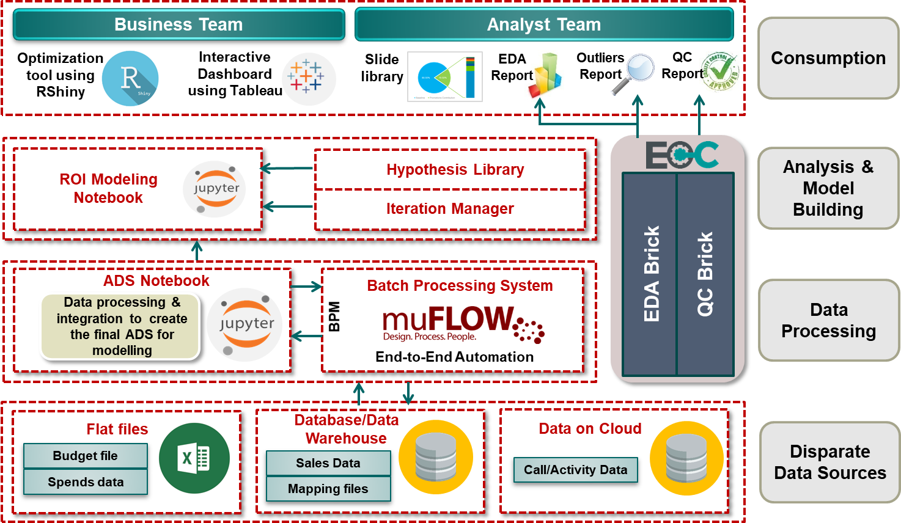
Promotional Response modelling (3/14)
A robust architecture would be established in order to ensure high quality reproducible outcomes
Illustrative

Slide 19




Promotional Response modelling (4/14)
Robust and automated data collation & quality control will ensure completeness and consistency for sparse datasets
Pre Modeling
Modeling
Automated Data Quality Process
Data Audit
Data Profiling
Outlier Analysis
Data Cleansing
Structured Data
Metadata Creation
Refined & Cleaned
Understanding nature of data
Data quality control checks
Assessing relative importance of variables
Understanding data integrity, consistency & completeness
Data imputation techniques such as Stochastic Regression to be used where data is missing
Anomaly identification
Distance based outlier detection
Clean when data exceeds pre-set limits
Standardization of data as per requirements and business rules
Transformation
Data Collation
Business Rules Implementation and Validation
Raw Data
Input Data
Master Data Management

Slide 20



Promotional Response modelling (5/14)
Exploratory Data Analysis utility will help in summarizing the main characteristics of variables prior to performing model iterations
Pre Modeling
Modeling
UTILITY
A
C
B
C
Master Data Management
Data Disaggregation
Exploratory Data Analysis
Variable Selection
Exploratory Data Analysis Utility will contain the below mentioned modules which will help to iterate quickly, scale easily and derive business insights
Descriptive Statistics
Variable Frequency
Summary Statistics
Missing Value Analysis
Univariate Distributions
Univariate Outlier Detection Analysis
Multivariate Outlier Detection Analysis
Correlation Matrix
Bivariate Distribution Plots
Trellis Plot
Correlation Network
Factor Analysis
Factor Loadings
Variance Explained
Uniqueness
Principal Component Analysis
Linear Discriminant Analysis
EDA Utility: Sample Screenshots

Slide 21
Promotional Response modelling (6/14)
We will follow a robust 2-step modeling methodology to ensure the best results for every brand-segment combination
Pre Modeling
Modeling
Enriched 2-Step method
Challenges faced across markets
Develop multiple transformation techniques on strong foundation of reproducible research
Linear-Linear
Log-Log
Linear-Log
Time Trend Variable
Dummy Variable
Interaction Variable
Sporadic investment in channels
Multi- Collinearity
Stable baseline
Mixed effects of promotions
Implement multiple modeling techniques to substantiate beta estimates and reflect confidence around them
Partial Least Squares
Multivariate Additive Regression Splines (MARS)
Structural equation models(SEM)
We anticipate these challenges to occur as we scale, and will build capability to tackle them
Mixed Effects (LME)
Generalized Additive Model (GAM)
Bayesian Hierarchical Model
Modeling Techniques
Model Validation

Slide 22

Promotional Response modelling (7/14)
During modeling, a number of factors will need to be considered to refine our analytical dataset
Pre Modeling
Modeling
UTILITY
A
C
B
C
Master Data Management
Data Disaggregation
Exploratory Data Analysis
Variable Selection
Modeling
Seasonality
Promotional Lag
Adstock
Event Analysis
Halo and Synergy

Slide 23
Promotional Response modelling (8/14)
Seasonality in sales has to be eliminated to avoid over/under estimation of sales and channel effectiveness
Pre Modeling
Modeling
Seasonality
Promotional Lag
Adstock
Event Analysis
Halo and Synergy
Sales of many products normally vary with time; different macro/micro economic factors, product lifecycle and various marketing activities contribute to these fluctuations
Such fluctuations need to be smoothened out to understand base sales and can be accounted either by using suitable modeling technique (ARIMA) or by introducing a seasonality index
Seasonality accounted by Seasonality Index
Seasonal
Peaks
Leads
Seasonality
Index

Slide 24
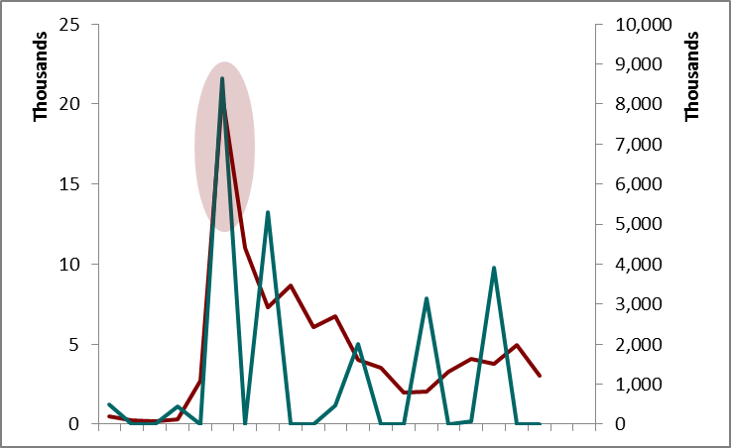
Promotional Response modelling (9/14)
Operational cycle time has to be accounted for to be able to measure true effectiveness of a channel
Pre Modeling
Modeling
Seasonality
Promotional Lag
Adstock
Event Analysis
Halo and Synergy
There is a delay in response generated since the time a marketing campaign is effected
This delay in response (lag) varies by marketing channel
This delay in response needs to be accounted for during model development to capture true effectiveness of marketing channels
Delay in response accounted

Slide 25
Promotional Response modelling (10/14)
Ad-stock transformation techniques enable discovery of suitable decay value for each channel
Pre Modeling
Modeling
Seasonality
Promotional Lag
Adstock
Event Analysis
Halo and Synergy
The effect of marketing activity is realized over a period of time*
This dynamic, or, decay effect of marketing can be mathematically modeled
Adstock transformation is an effective method of capturing the decay effect
*in detail explanation

Slide 26
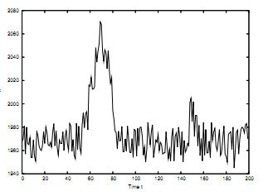
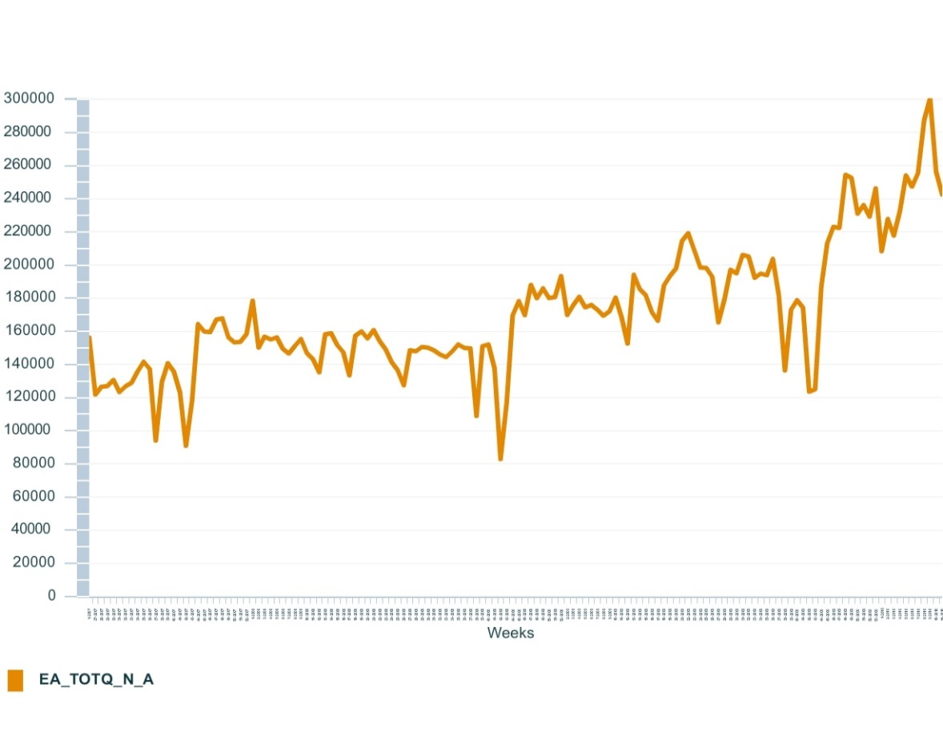
Promotional Response modelling (11/14)
Event analysis identifies sudden changes in sales due to special events
Pre Modeling
Modeling
Seasonality
Promotional Lag
Adstock
Event Analysis
Halo and Synergy
Specific events (competitor activity, holidays, one time events) can cause spikes in sales response
Events need to be identified before modeling and included in the model using indicators or event profiles that can model their effect
Pre-post analysis of sales can give an initial estimate of Event impact during the pre-modeling phase
Focused promotions, weather events, etc. can lead to spikes
Competitor activity, product launches, etc. can lead to drop in sales
Week 38
Week 37
Week 38
Week 42
Week 42
Jan 2015
Week 42
Jan 2016
Jan 2017

Slide 27
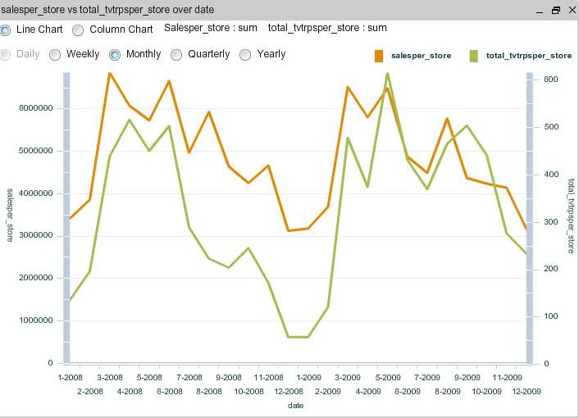
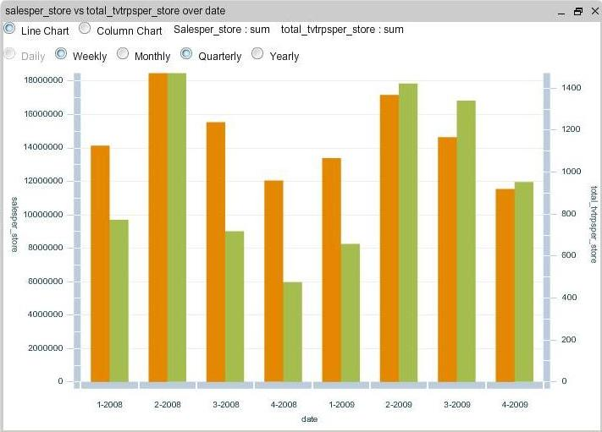
Promotional Response modelling (12/14)
Comparing time series plots identifies the channels with a halo effect over the sales of the observed channel
Pre Modeling
Modeling
Seasonality
Promotional Lag
Adstock
Event Analysis
Halo and Synergy
A simultaneous time series analysis revealed the channel spends that were directly proportional to observed channel sales.
The rise and fall (over time) in the channel sales could be correlated to the change in marketing activities across other channels.
The insights gained from correlation and time-series analysis helped us to differentiate the channels that have a halo effect.
Other Channels Spend
Channel Sales
Channel Sales
Other Channels Spend
Time series line charts of channel sales and other channels spend exhibit similar variation patterns
Time series bar-charts for channel sales and other channels spend

Slide 28
Promotional Response modelling (13/14)
Robust optimization engine coupled with user friendly interface enables seamless simulation of multiple business scenarios
OBJECTIVE
Optimal channel-mix guidance for budget planners
Evaluation and comparison of multiple media mix scenarios
Simplicity
Aesthetic design
Intuitive to business users
Feature Rich
Scenario planning
Dynamic constraints
Optimization at multiple levels
User Interface
Coverage
Optimize multiple models simultaneously
Optimize selected marketing channels
Seamlessly Integrated
Independent of modeling methodology
Flexible to use model results from multiple sources
Methodology Agnostic
Loosely Coupled
PLAN
Tool for remote access and better visualization
Creation of user-profiles and login-based permissions
Central repository for easy access to historical data
Access to outputs at intermediate iterations
White box Solution
Optimization
Engine
Minimal efforts for enhancements and support required for implementing established algorithms
Modular Design

Slide 29
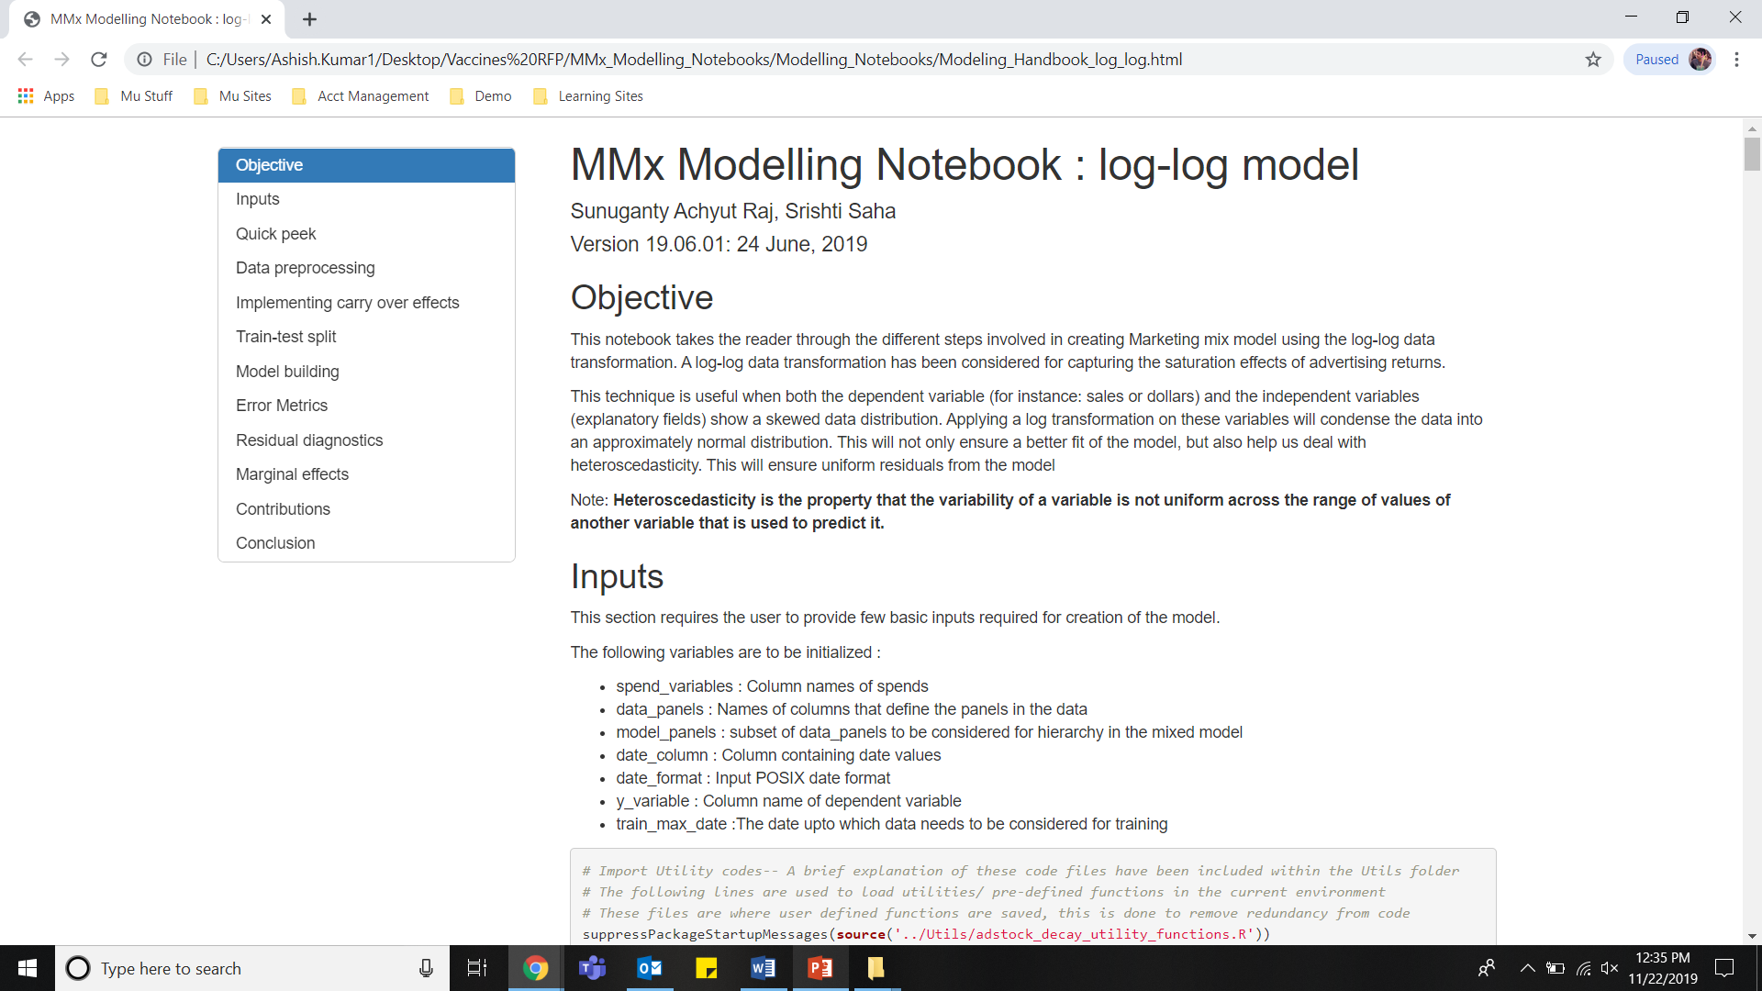
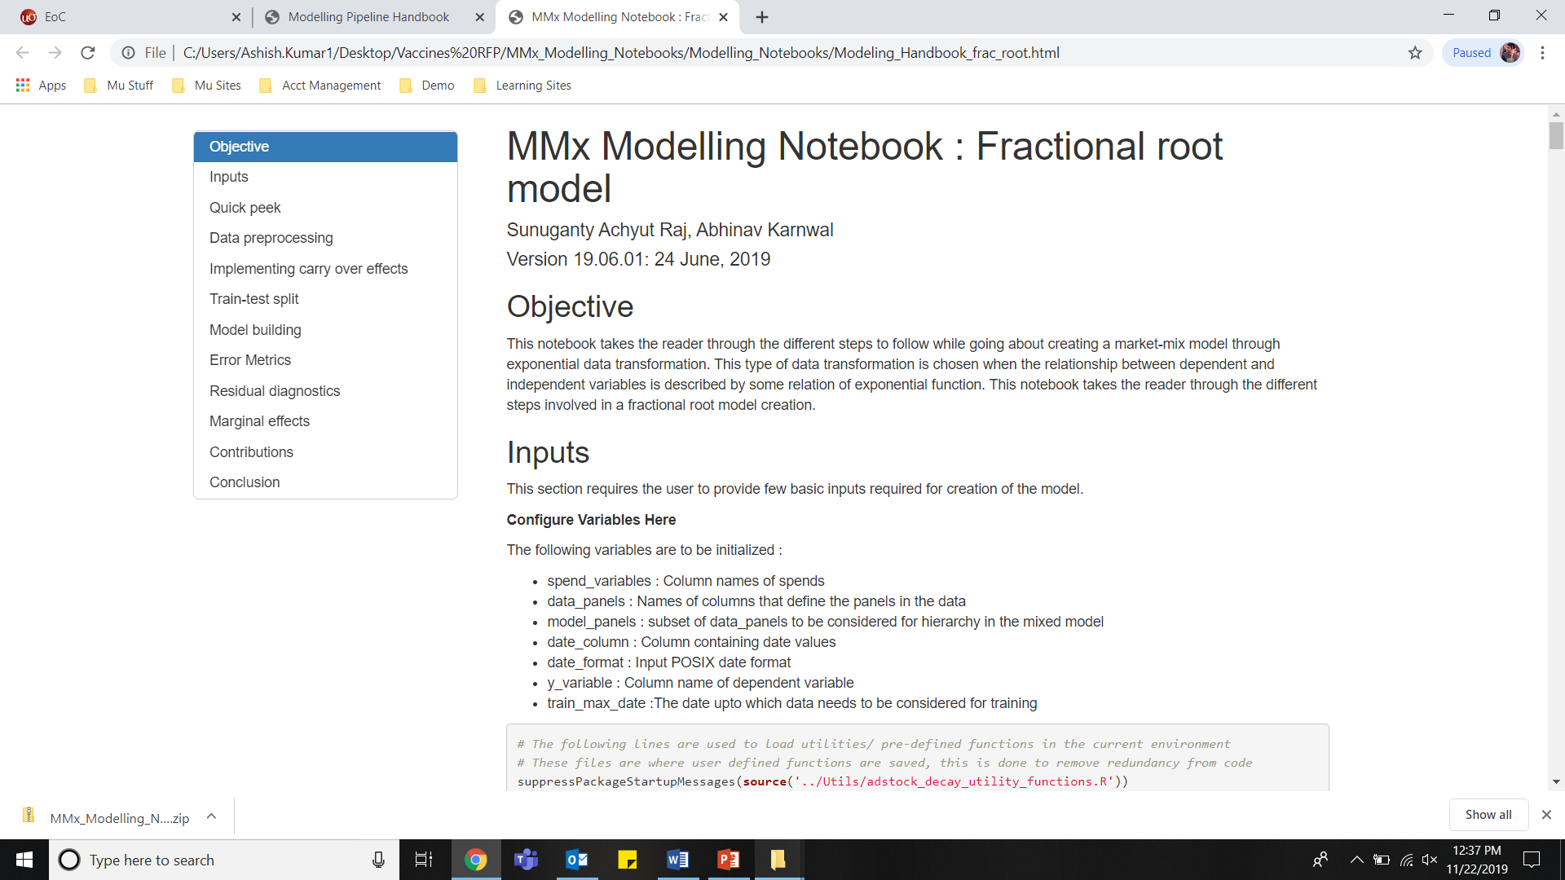
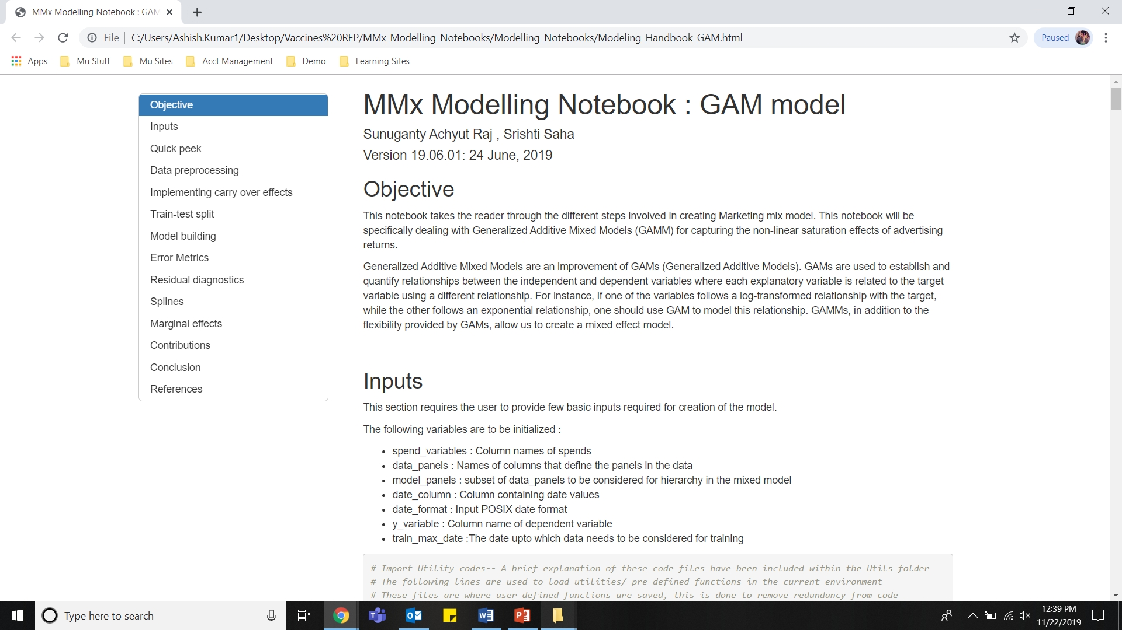
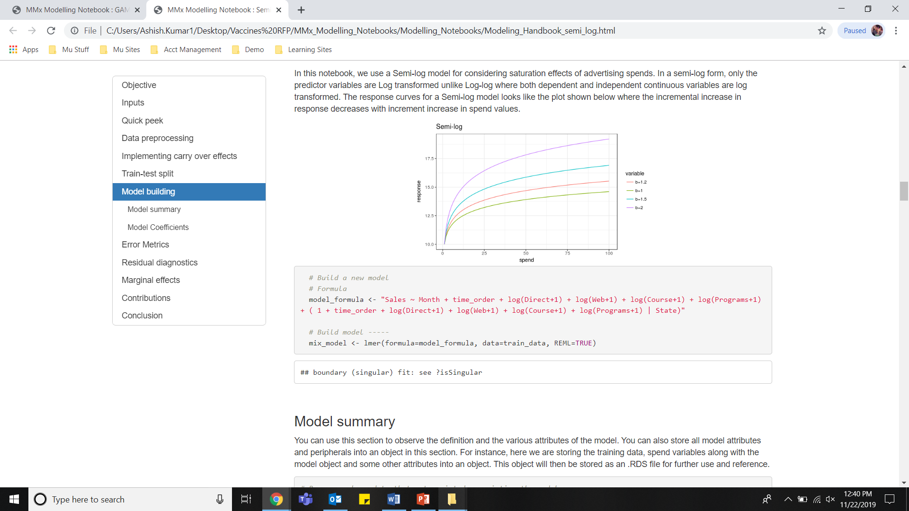
Promotional Response modelling (14/14)
Promotional Response Modeling:
Mu Sigma’s pre-built advanced analytics accelerators enable quick experimentation, helping stakeholders converge faster
Log-Log model reusable accelerator
Fractional root model reusable accelerator
GAM model reusable accelerator
Semi-Log model reusable accelerator

Slide 30
Solution Approach – 5 step process
While delivering immediate value, Mu Sigma will help client build long-term capability through advanced analytics in areas of promotional response modeling and sales force effectiveness
PROMOTIONAL RESPONSE MODELING
ALIGNMENT DESIGN
01
Brand-segment level response curves
Approach – Rapid simulations enabled by using pre-built reusable Mu Sigma accelerators
03
Optimal territory alignment for KAM & VS sales teams
Approach – Evaluation across four dimensions of workload, travel efficiency, sales potential and disruption
05
SEGMENTATION
Sizing simulation
PEOPLE PLACEMENT
Brand level account segmentation
Approach – Thorough Exploratory analysis followed by experimentation with multiple segmentation models
02
Sizing scenarios based on brand-segment level response curves and brand team inputs for KAM, VS teams
Approach – IROI based optimization by iterating through multiple business scenarios
04
Best People Placement Recommendation
Approach – Evaluate between placement optimization and best-fit approach based on business requirements and exploratory analysis

Slide 31
Sizing (1/5)
Step III: Sizing: Product segments will be combined based on similar responsiveness and multiple optimization scenarios will be simulated to determine the right sales force size
OPTIMIZATION
ILLUSTRATIVE
IROI based optimization
Incremental Sales
0% IROI point will mean that no more calls are assigned when the incremental return of another call is less than cost of that call
-25% IROI point will mean that no more calls are assigned when the incremental return of another call is less than 75% of the cost of that call
+100% IROI point will mean that no more calls are assigned when the incremental return of another call is less than 200% of the cost of that call
Cost of details
0% IROI
+100% IROI
-25% IROI
Value from sales-force
Effort (PDEs)
Higher IROI hurdle
Lower IROI hurdle
Profit optimisation is the goal
Alternative investment options with high ROI available
High level of perceived risk in the future environment
High risk of not achieving base case sales forecasts
Sales maximization is a strategic objective
Share of voice maximization is important
Aggressive sales targets for portfolio
Low level of perceived risk in the future environment
Low level of risk of not achieving base case sales forecasts

Slide 32
Sizing (2/5)
Step III: Sizing: Some of the scenarios we will experiment with
ILLUSTRATIVE
“Base case”
the current situation
The base case represents a scenario that describes the current situation for sales force in 2019
“Re-allocation scenario”
optimise the base case
This scenario allows to improve the financial result of the base case by re-allocating existing resources (optimization)
An optimal solution with the current SF size
This situation represents the 0% IROI point on the curve
“Sales maximizing scenario”
aggressive strategy
A further increase in the resources would allow to improve the overall contribution further although this might be aggressive
This situation represents the -25% IROI point on the curve
“Divestment scenario”
less risk taking strategy
Alternative scenario is a divest strategy that would allow to reduce SF effort still at a high profitability
This situation would be closer to the 150% IROI point on the curve

Slide 33

Sizing (3/5)
Step III: Sizing: Product segments will be combined based on similar responsiveness and multiple optimization scenarios will be simulated to determine the right sales force size
Input
Process
1
DECISION VARIABLES
Every potential call that can generate non-zero incremental sales
Response Modeling
Output
Product A
Optimal Reach & Frequency
Product B
Optimization
Optimized
LT Contribution
Product C
2
OBJECTIVE FUNCTION
Present Value of Incremental Sales projected over a long term minus Present Value of sales costs
LT Contribution
Base case
Product Details
CONSTRAINTS
E.g. Completion rate
E.g. One product detailed once in a call
Sales reps
Based on similarity of responsiveness, product segments will be combined
3
Planned Results
Financial projections of sales, profits, costs and Value from sales
Recommended PDEs by Product and Calls by Specialty

Slide 34
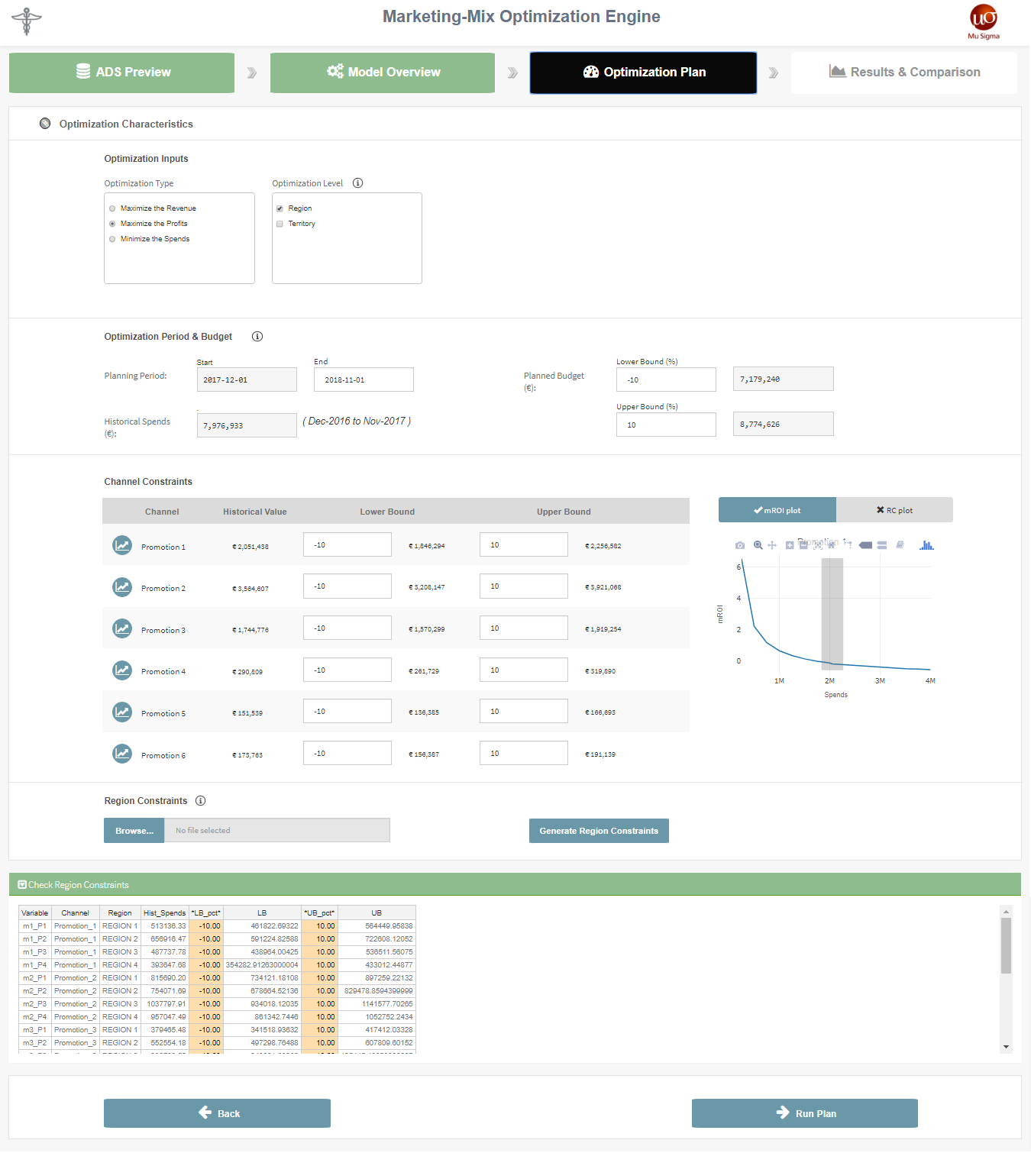
Sizing (4/5)
User friendly optimization & simulation platform will allow users to perform simulations on different scenarios to get the most accurate outputs
1
Optimization Characteristics
Choose optimization type and level
2
Optimization Period & Budget
Enter planning period &
Enter constraints on planned budget
3
Channel Constraints
Modify channel constraints based on Response curves
4
Region Constraints
Add constraints at granular level

Slide 35
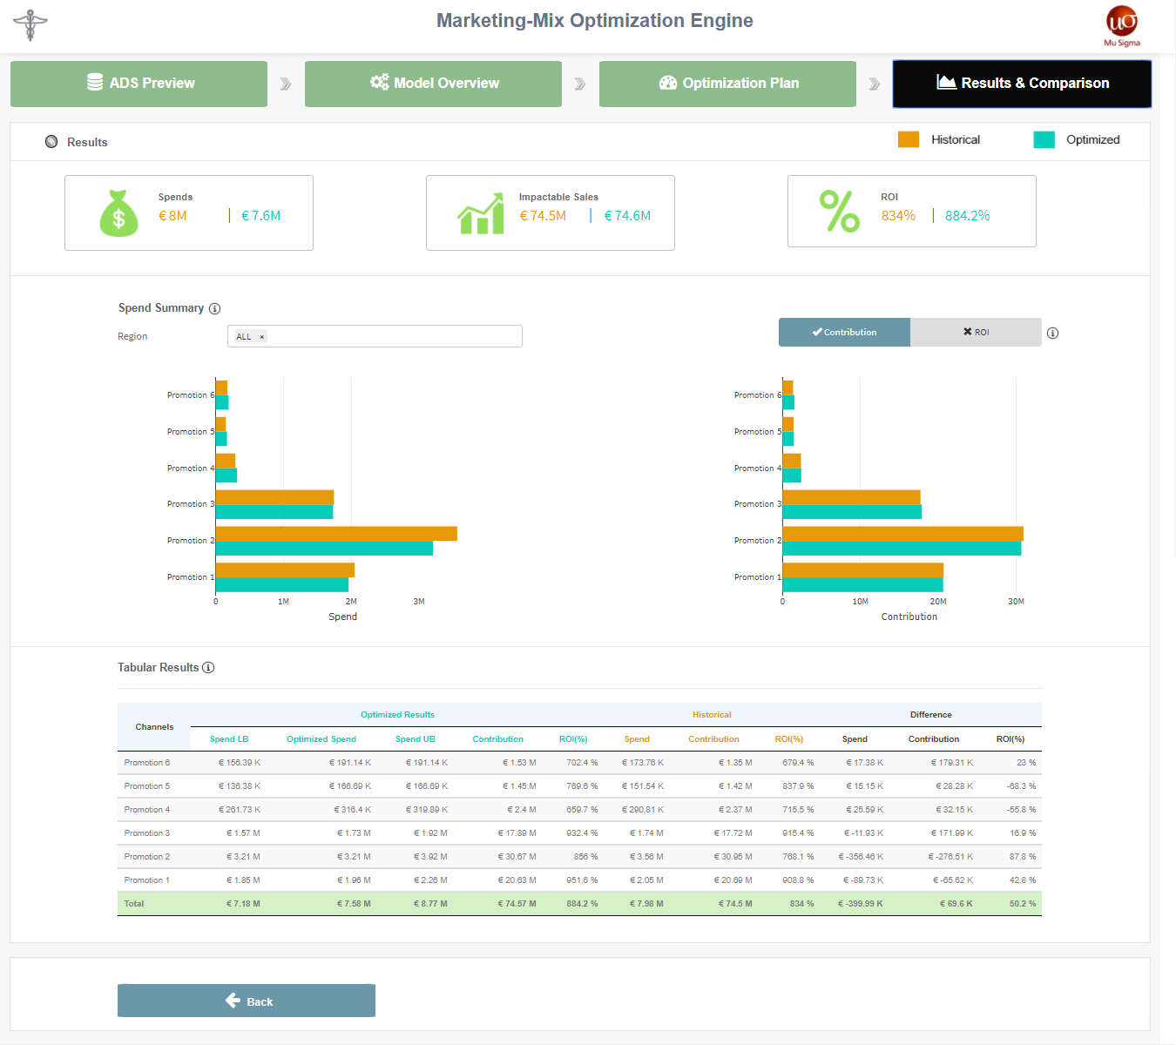
Sizing (5/5)
Results for Promotional response scenario can be viewed and compared with historical data in a user friendly view
1
Results
Compare key optimized results
2
Spend Summary
View channel wise spends, contribution and ROI changes
3
Tabular Results
View tabular form with in-depth result details

Slide 36
Solution Approach – 5 step process
While delivering immediate value, Mu Sigma will help client build long-term capability through advanced analytics in areas of promotional response modeling and sales force effectiveness
PROMOTIONAL RESPONSE MODELING
ALIGNMENT DESIGN
01
Brand-segment level response curves
Approach – Rapid simulations enabled by using pre-built reusable Mu Sigma accelerators
03
Optimal territory alignment for KAM & VS sales teams
Approach – Evaluation across four dimensions of workload, travel efficiency, sales potential and disruption
05
SEGMENTATION
Sizing simulation
PEOPLE PLACEMENT
Brand level account segmentation
Approach – Thorough Exploratory analysis followed by experimentation with multiple segmentation models
02
Sizing scenarios based on brand-segment level response curves and brand team inputs for KAM, VS teams
Approach – IROI based optimization by iterating through multiple business scenarios
04
Best People Placement Recommendation
Approach – Evaluate between placement optimization and best-fit approach based on business requirements and exploratory analysis

Slide 37
Territory Alignment (1/11)
Step IV: Territory Alignment
Territories would be evaluated across 4 main dimensions in order to analyze value of a territory and alignment design balance
Dimensions
Territory value and alignment balance benefits
Workload
Balanced workload across territories
Better coverage and higher productivity
Enhanced customer coverage
Travel Efficiency
Shorter windshield time
More face time with customers
Reduced associated travel cost
Optimized travel Time
Sales Potential
Equitable distribution of opportunity
Fairer incentive compensation
Improved morale
Fair Opportunity
Disruption
Minimized sales relationship disruption
Lower transition cost
Controlled Disruption

Slide 38
Territory Alignment (2/11)
Step IV: Territory Alignment
The dimension can be evaluated by quantifying and analyzing the following indices/metrics
Workload Index (WI): Workload required to optimally reach all target aligned to a territory
Targets Coverage: No. of targets coverage by segments within the territory
Compactness Index (CI): Quantify geographical distribution of targets to analyze compactness of territories
Payer Mix Index (PMI): Distinguishes territories with different mix of payers and margins (profit opportunities)
Sales Potential Index (SPI): Opportunity assessment of territories based on the market sales volume
Access Index (AI): Captures accessibility of the Physicians of a territory
Sales Index (SI): Evaluates territories based on the brand sales volume
Workload
Travel Efficiency
Sales Potential
Disruption
Disruption Index (DI): Measures disruption of customer relationships during territory re-design exercise

Slide 39
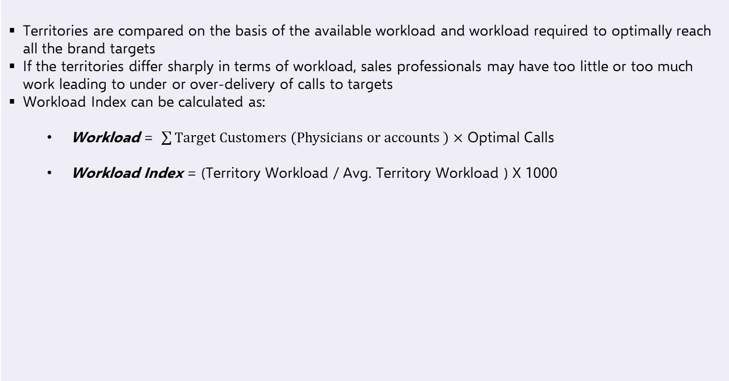
Territory Alignment (3/11)
Step IV: Territory Alignment
Workload index is an indication of high/low workload capacity of a territory compared to the average territory workload
Workload
Territories are compared on the basis of the available workload and workload required to optimally reach all the brand targets
If the territories differ sharply in terms of workload, sales professionals may have too little or too much work leading to under or over-delivery of calls to targets
Workload Index can be calculated as:
Workload = $\sum{Target Customers \left(Physicians or accounts \right)×}$ Optimal Calls
Workload Index = (Territory Workload / Avg. Territory Workload ) X 1000
Illustrations
High Workload
Low Workload

Slide 40
Territory Alignment (4/11)
Step IV: Territory Alignment
Uniform target coverage across territories ensures fair and equal opportunity for sales professional
Target Coverage
Territories must have fairly uniform distribution of targets by segment, thereby ensuring optimal opportunity across territories
Uneven distribution of segments across territories or very few or high number of targets may result in some sales professionals being at a disadvantage
Target coverage can be assessed by analyzing:
Total number of targets for each territory and,
Distribution of targets by segments for each territory
Illustrations
Segment1
Segment2
Segment3

Slide 41
Territory Alignment (5/11)
Step IV: Territory Alignment
Access Index can be used along with Workload Index to identify territories to provide more opportunity
Access Index
Access Index can be used to measure accessibility of physicians for that particular sales team in that territory
Call Plan physicians who have been consistently given zero calls over the previous call plan cycles are classified as inaccessible
Physicians who are affiliated to IDNs may be classified as inaccessible because of IDN influence
Access Index = ( # Call Plan physicians - # Inaccessible Call Plan physicians )
/ ( # Call plan Physicians)
Illustrations
Low Workload and Low access

Slide 42
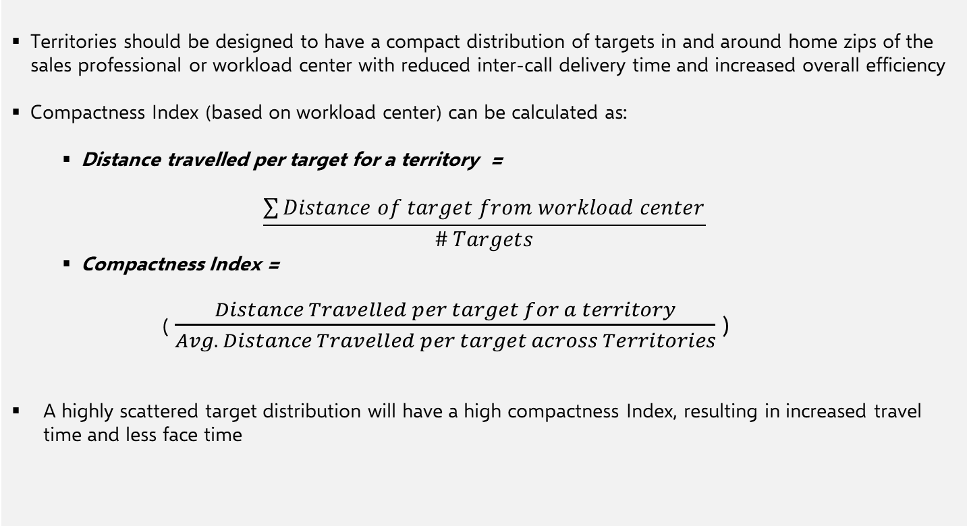
Territory Alignment (6/11)
Step IV: Territory Alignment
Compactness Index is a measure of geographical spread of targets within a territory
Compactness Index
Territories should be designed to have a compact distribution of targets in and around home zips of the sales professional or workload center with reduced inter-call delivery time and increased overall efficiency
Compactness Index (based on workload center) can be calculated as:
Distance travelled per target for a territory =
$$\frac{\sum{Distance of target from workload center}}{\# Targets}$$
Compactness Index =
( $\frac{Distance Travelled per target for a territory}{Avg. Distance Travelled per target across Territories}$ )
A highly scattered target distribution will have a high compactness Index, resulting in increased travel time and less face time

Slide 43
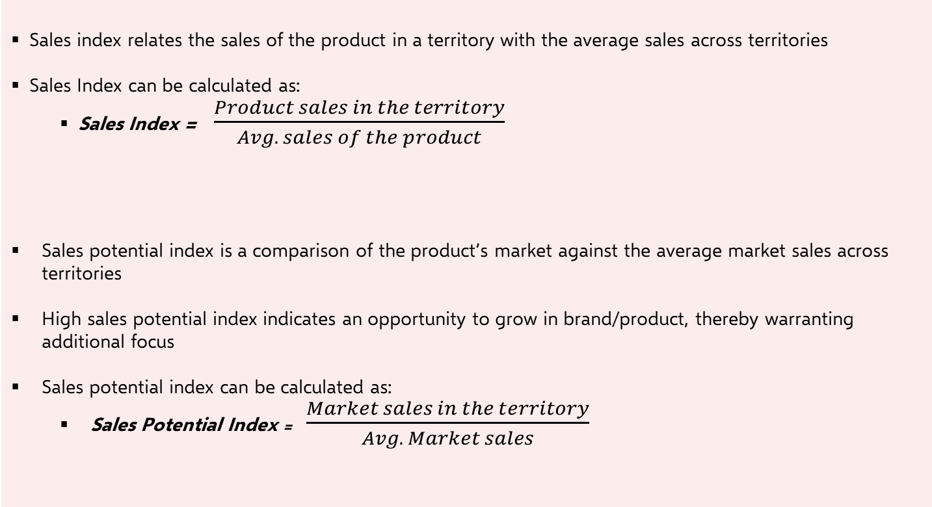
Territory Alignment (7/11)
Step IV: Territory Alignment
Sales and Potential indices help in assessing opportunity and growth prospects of territories
Sales Index
Sales index relates the sales of the product in a territory with the average sales across territories
Sales Index can be calculated as:
Sales Index = $\frac{Product sales in the territory}{Avg. sales of the product}$
Sales potential index is a comparison of the product’s market against the average market sales across territories
High sales potential index indicates an opportunity to grow in brand/product, thereby warranting additional focus
Sales potential index can be calculated as:
Sales Potential Index = $\frac{Market sales in the territory}{Avg. Market sales}$
Sales Potential Index

Slide 44
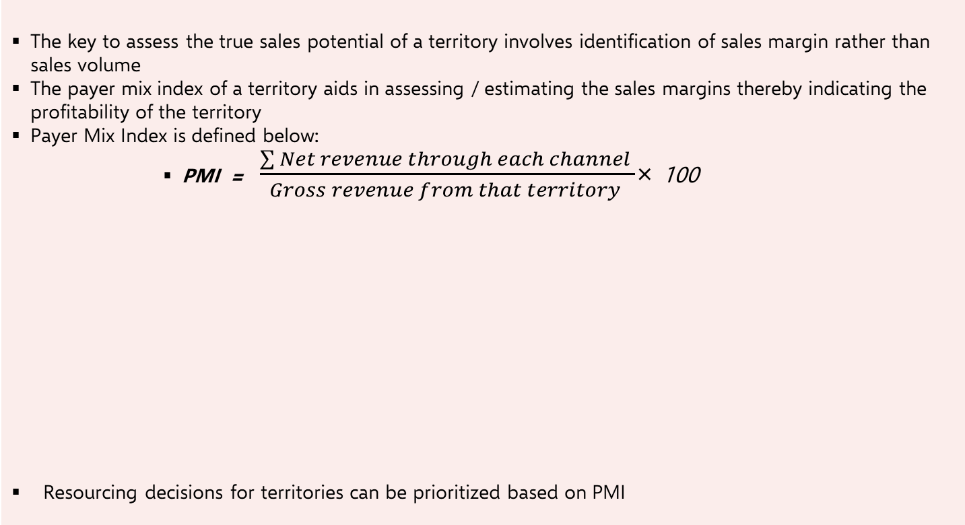
Territory Alignment (8/11)
Step IV: Territory Alignment
Payer mix index (PMI) is an indication of the profitability of a territory and can help prioritize resourcing decisions
Payer Mix Index
The key to assess the true sales potential of a territory involves identification of sales margin rather than sales volume
The payer mix index of a territory aids in assessing / estimating the sales margins thereby indicating the profitability of the territory
Payer Mix Index is defined below:
PMI = $\frac{\sum{Net revenue through each channel }}{Gross revenue from that territory }$× 100
Resourcing decisions for territories can be prioritized based on PMI
Territory A
 | Cash | 3rd Party | Medicaid | Total
Total Sales (Rx) | 2,000 | 20,000 | 3,000 | 25,000
% Total | 8% | 80% | 12%
Margin Index | 1 | 0.9 | 0.65
% Net Revenue | 8% | 72% | 7.80% | 87.80 PMI

Slide 45
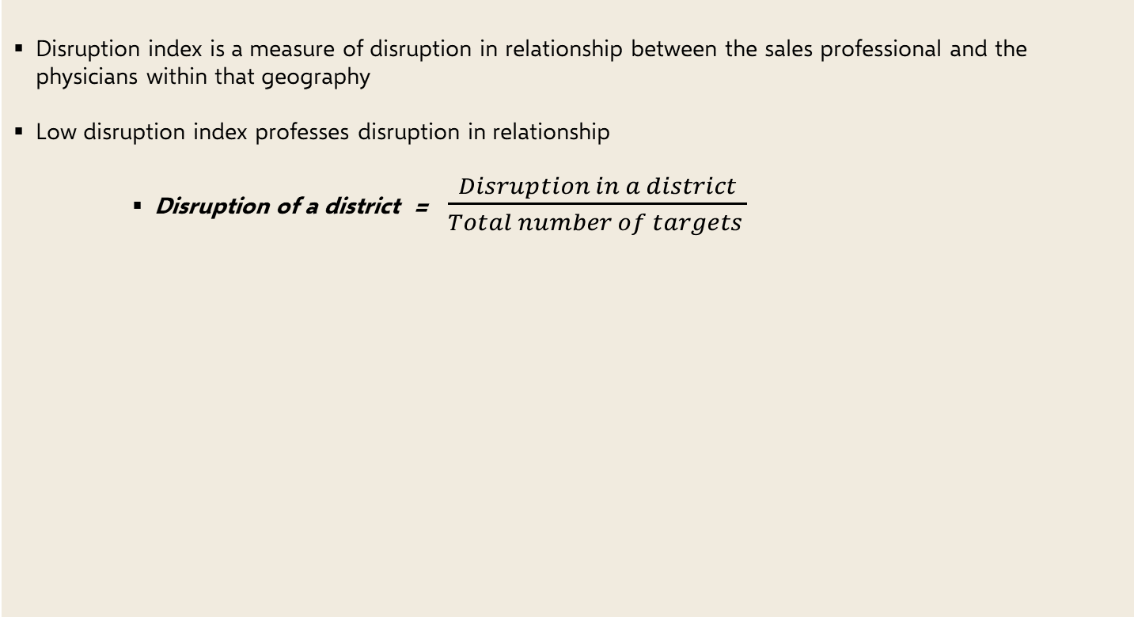
Territory Alignment (9/11)
Step IV: Territory Alignment
Disruption Index quantifies the disruption of sales professional and physician relationships due to alignment changes
Disruption Index
Disruption index is a measure of disruption in relationship between the sales professional and the physicians within that geography
Low disruption index professes disruption in relationship
Disruption of a district = $\frac{Disruption in a district}{Total number of targets }$
Illustrations
High Disruption

Slide 46
Territory Alignment (10/11)
Step IV: Territory Alignment
Localized resourcing decisions can be enabled by analyzing the Sales Index and Payer Mix Index of territories
Territory Resourcing Prioritization
Territories with Low Sales & High Profit
Territories with High Sales & High Profit
Low value territories but provide high profits
Should be prioritized for staffing
Highest value territories in terms of sales and profitability
Should be optimally resourced and prioritized staffing
Territories with Low Sales & Low Profit
Territories with High Sales & Low Profit
Low value territories in terms of sales and profit
Should be prioritized for closure
High value territories in terms of sales but have low profitability
Staffing should be based on sales and PMI and not sales alone
Application: This analysis will be useful to enable localized resourcing decisions for the DSP/ DPC sales force

Slide 47
Territory Alignment (11/11)
Step IV: Territory Alignment
Alignment Scenarios can be compared to understand trade-offs and determine operationalization capability
Index Comparison to evaluate multiple Alignments
Alignment Comparison
Illustrations
Multiple alignment scenarios can be compared on indices to evaluate operationalization capability
The incremental gain provided by a new alignment over the incumbent alignment can be quantified
Trade-offs across alignments can be understood and localized tweaks can be made by deployment
Application: This analysis can be used to understand the gains from the proposed team alignment and the existing alignment

Slide 48
Solution Approach – 5 step process
While delivering immediate value, Mu Sigma will help client build long-term capability through advanced analytics in areas of promotional response modeling and sales force effectiveness
PROMOTIONAL RESPONSE MODELING
ALIGNMENT DESIGN
01
Brand-segment level response curves
Approach – Rapid simulations enabled by using pre-built reusable Mu Sigma accelerators
03
Optimal territory alignment for KAM & VS sales teams
Approach – Evaluation across four dimensions of workload, travel efficiency, sales potential and disruption
05
SEGMENTATION
Sizing simulation
PEOPLE PLACEMENT
Brand level account segmentation
Approach – Thorough Exploratory analysis followed by experimentation with multiple segmentation models
02
Sizing scenarios based on brand-segment level response curves and brand team inputs for KAM, VS teams
Approach – IROI based optimization by iterating through multiple business scenarios
04
Best People Placement Recommendation
Approach – Evaluate between placement optimization and best-fit approach based on business requirements and exploratory analysis

Slide 49
People Placement (1/7)
Step V: People Placement
A stepwise process would be followed for placement enabling effective execution and pro-active communication
Sales rep placement Process
Finalize Territory Alignments
Define Placement Rules & Criterions
Design & Setup Placement Process
Generate Scenarios & Diagnostics
Final Results & Field Force Communication
Create alignment database and index
Territory design based on common objectives
Balanced workload
Balanced Sales Potential
Maximize coverage
Travel time reduction
Fair IC plan
Define sales rep eligibility and prioritization criterions
Distance
Pay Scale
Performance
Tenure
Specialized experience
Bus. Continuity
Confirm rules with HR and legal
Design process flows and assignment algorithm
Maximum placements
Best fit placements
Establish exhaustive QA process and perform mock runs
Multiple scenarios are created in line with business objectives
Placements diagnostics are provided for each scenario to enable clear decision making
Best scenario which meets the business objective is selected
Final placements results shared with business and HR/Legal
Extended placements options are provided for displaced SPs, if required
Communication packages are created at each level for field communication
Stakeholders
Operations
Sales leadership
Stakeholders
Operations
Sales leadership
HR & Legal
Stakeholders
Operations
Sales leadership
Stakeholders
Operations
Sales leadership
Stakeholders
Operations
Sales leadership
HR & Legal

Slide 50
People Placement (2/7)
Step V: People Placement
Placement optimization & Best-fit approach will be adopted based on specific business requirements
Placement maximization
This approach is suitable to be used when multiple sales rep are eligible for multiple roles & a best sales rep to position combination is not a necessity. Hungarian algorithm is used for optimization
Best-fit placements
In some cases business demands dictate that the job profile to be filled is of a specialist nature and it is desirable that a specific best-fitting sales rep be placed in the position, over a pool of fairly eligible sales rep.
The results from placement optimization algorithm would differ from best-fit results in cases where multiple sales rep are eligible for the same position.
The optimization would enable a sales rep to be placed in a position that is not a best-fit in order to place a sales rep who has lesser options & thereby reducing the overall unplaced sales reps
A comparison of best-fit placements v/s placements through optimization algorithm is also performed to understand the variation in both scenarios & help decide the approach be followed

Slide 51
People Placement (3/7)
Step V: People Placement
A step-by-step process including thorough QC & analysis of winning criteria is adopted for the placement exercise
1
Input collation & quality checks
Multiple input files received from different sources are collated & thoroughly QCed at this stage
The files are then converted to a suitable input format that is in-line with the placement process
2
Eligibility list creation & combination ranking
Based on the criteria for eligibility of a sales rep into a position, a list of eligible sales rep to position file is created
Each combination of eligible sales rep to position is valued across various dimensions & provided a unique rank which is equivalent to the cost of that placement
3
Placement Optimization
1:1 assignment of sales rep to position is performed using the Hungarian algorithm/ best-fit placement
Results across various placement scenarios are analyzed & compared to choose the best scenario for placement
4
Sales rep winning criteria & Extended placement options
Thorough QC is performed on the process & results. Winning criteria for every placement is analyzed & the reason for no unplaced sales rep is provided
For every unplaced sales rep extended placement options are explored. Extended placement options are performed by relaxing the placement criteria & business rules

Slide 52
People Placement (4/7)
Step V: People Placement
The following data sources and metrics would be leveraged for the analysis
Sales rep data
Sales rep roster with home location (state, city, zip)
Sales rep experience: Performance Rating (PRW), segment breadth/ experience, tenure in the Company, Potential
Previous placed geography, previous list of target physicians/ accounts
Alignment data
Zip-to-geography alignment
Geography workload center
Other files
Zip to latitude & longitude mapping
Water body infringement
Performance rating (PRW): PRW scores for 2/3 years are considered & a weighted score is calculated
Segment breadth/ experience: Experience in #days/ #years in a particular profile
Project tenure: Tenure within Company in terms of #days/ #years
Potential: A Company defined flag depicting the potential of a sales rep into categories like: High Potential, Early Potential, New Entrant, Expert, etc.
Water body infringement: List of zips in states which are separated by water bodies/ marshes
Latitude-longitude mapping: Zip to latitude-longitude coordinate mapping for distance calculation
Distance calculation: Haversine formula is used to calculate the distance between to zip coordinates. The coordinates/ latitude-longitude for zips is used for this purpose. Haversine/ great-circle distance formula calculates the distance across the curvature of earth. This formula is the closest to the shortest distance between 2 points on a sphere.

Slide 53
People Placement (5/7)
Step V: People Placement
We will deliver efficient results in terms of output, diagnostics, and final deliverables
Placement output
Sales rep to geography placement with placement parameters
Extended placements
Eligible list of sales rep
Placement Diagnostics
Summary of overall placements
Diagnostics of overall placement through various scenarios in terms of Distance, physician Continuity & other placement criteria
Comparison of various placement scenarios
Comparison of best-fit with optimization results
Diagnostic deck with final business rules & results
Other deliverables
Communication Package
From-to file
Vacancy list to HR for interviews

Slide 54
People Placement (6/7)
Step V: People Placement
Optimization – a high cost or rank is assigned to combinations where the sales rep is ineligible for the geography
Alignment
Optimal assignment scenario with minimal cost
T1
T3
R1
1
T1
Alignment
T2
4
R1
1 | 4 | 999
9 | 2 | 6
3 | 7 | 8
999
T1
T2
T3
R2
9
T2
R1
1 | 4 | 999
9 | 2 | 6
3 | 7 | 8
2
Sales rep
R2
6
Sales rep
R2
R3
R3
3
7
T3
8
R3
Cost of assignment
Cost of assignment=11
Sales rep | R1 | R1 | R1 | R2 | R2 | R2 | R3 | R3 | R3
Geography | T1 | T2 | T3 | T1 | T2 | T3 | T1 | T2 | T3
Distance from working geography | 50 miles | 60 miles | - | 70 miles | 55 miles | 65 miles | 55 miles | 65 miles | 65 miles
physician/ Business continuity | 40% | 60% | 0% | 20% | 40% | 40% | 45% | 30% | 25%
Rank | 1 | 4 | 999 | 9 | 2 | 6 | 3 | 7 | 8
In cases where a sales rep is not eligible for a geography a high cost or rank is assigned to that combination in the cost matrix to avoid that assignment from happening.

Slide 55
People Placement (7/7)
Step V: People Placement
Optimization – Hungarian Algorithm works by reducing the overall cost of assignment; resultant solution is optimally maximized at minimal cost.
Hungarian algorithm is an assignment optimization algorithm that works by reducing the overall cost of assignment. The resultant solution is optimal maximized & with minimal cost.
Alignment
Optimal assignment scenario with minimal cost
T1
T3
R1
1
T1
Alignment
T2
4
R1
1 | 4 | 5
9 | 2 | 6
3 | 7 | 8
5
T1
T2
T3
R2
9
T2
R1
1 | 4 | 5
9 | 2 | 6
3 | 7 | 8
2
Sales rep
R2
6
Sales rep
R2
R3
R3
3
7
T3
8
R3
Cost of assignment
Cost of assignment=10
The matrix that is input to the algorithm is the cost matrix which is populated with the cost associated with each of the assignment, i.e. combination of row & column variables. In sales rep assignment problems, each assignment is valued across various parameters & a rank is assigned to each, which is in turn input to the algorithm.
Sales rep | R1 | R1 | R1 | R2 | R2 | R2 | R3 | R3 | R3
Geography | T1 | T2 | T3 | T1 | T2 | T3 | T1 | T2 | T3
Distance from working geography | 50 miles | 60 miles | 60 miles | 70 miles | 55 miles | 65 miles | 55 miles | 65 miles | 65 miles
physician/ Business continuity | 40% | 60% | 0% | 20% | 40% | 40% | 45% | 30% | 25%
Rank | 1 | 4 | 5 | 9 | 2 | 6 | 3 | 7 | 8

Slide 56
Why Mu Sigma?

Slide 57
Why Mu Sigma? Mu Sigma will act as a Sherpa in building analytics capabilities in-house for you by leveraging and delivering white-box reusable accelerators
Our understanding of your organization:
We have partnered with you since 2011 across various divisions
01
05
Mu Sigma’s solution is:
Whitebox: All algorithms and techniques are open for discussion
Based on good collaboration with you
Flexible for change in requirements
Uses reusable components for quick turnaround
Can be extended to build a platform in the future for reduced cost
02
Mu Sigma will be the right partner for you for this engagement
03
Our experience in life sciences:
Mu Sigma understands the US life sciences business very well with 14+ years of experience in this business
04
Building capability in-house:
Mu Sigma will, over time, enable you to build its internal capabilities
We will run workshops within your organization to train its internal team
Mu Sigma is a leader in Analytics:
We continue to be world’s #1 analytics company

Slide 58
What will we deliver?

Slide 59














Key deliverables
Mu Sigma will engage with you through various touchpoints in the form of intermediary deliverables until the delivery of the complete solution
Deliverables
1
AoPS™
Framework
2
3
4
SGQ - Problem definition
Representation Map
Hypothesis Matrix
Project plan with week level work progress
Data Request sheet with data file details, tables etc.
Analytical Datasets
5
6
7
8
Business Process Flow
Analytical Data Flow
Decision Flow Diagrams
Exploratory Data Analyses Reports
Detailed Architecture Diagrams and Change Management Recommendations
White-box Analytical Models across all 5 parts of the journey
9
10
Segments
Response Curves
Alignment Indices
Headcount Analysis
Sales Force Sizing – Scenario Builders
Reporting of Sizing Results
People placement recommendations
Knowledge Transfer and Training Document
Workshops and Roadshows

Slide 60
Executive Summary
Solution Design
Who we are
Engagement & Governance Model
Timelines and Cost
Experience in Promotional Response Modeling and Sales Force Effectiveness
AGENDA

Slide 61







We at Mu Sigma (μσ)…
…help you build next-gen problem solving capability
Largest pure-play Big Data Analytics & Decision Support company
DECISION SUPPORT STACK
~140 Fortune 500 clients (many Fortune 100) in US, Europe & Australia
D³
Over 3,500 Decision Scientists
Decision Sciences
Interactive Ecosystem – People, Processes and Platforms
Data Sciences
Supplier of the year at Walmart and Microsoft
Data Engineering
Hyper-growth unicorn company funded by world class investors
Featured in Forbes’ 40/40, EY and ET Entrepreneur of the Year
DATA

Slide 62




































































































































We are catalysts for making Big Data, AI, ML and decision sciences REAL in leading corporations…

Slide 63
Healthcare Industry : Our experience
We have worked across the value chain in the life sciences space for pharma, vaccines, medical devices, payors, and retail pharmacies
R & D
Manufacturing & Supply Chain
Managing Markets
Marketing
Sales Operations & Effectiveness
Human Resources & Misc. Operations
CLINICAL TRIAL OPERATIONS
Patient recruitment and planning
Site selection
Partnership/CRO assessment
Study completion forecasting
HEOR
Market share assessment
Signal detection for safety and AE
Healthcare cost and resource utilization
Treatment pathways
Patient/provider characteristics
Disease progression
Quality of life assessment
MEDICAL AFFAIRS
MSL performance evaluation
Medical call enter analytics
Content efficacy
Online medical information optimization
CSAT analytics
CUSTOMER DRIVEN PLANNING
Cost to serve
Go to market strategy
Supply chain segmentation
Customer segmentation
SUPPLIER MANAGEMENT
Supplier segmentation
Contract management
Supplier performance management
Procurement cost optimization
Supplier performance analysis
Supply scheduling
AGILE MANUFATURING
Sales and demand forecasting
Lead time optimization
Demand planning
Forecast accuracy analysis
PAYER ANALYSIS
Payer segmentation
Cost-benefit analysis for contract optimization
Co-pay analysis
Formulary analysis
PRICING & CONTRACTING
Pricing and Rebates
Contracting
Pre/post contract assessment
Claims validation
Opportunity assessment
Chargeback analysis
Executive KPI reporting
IDN STRATEGY
IDN hierarchy / affiliation
IDN control / influence
IDN targeting
CUSTOMER TARGETING
Segmentation and Profiling
IDN networking and targeting
Customer lifetime value
PATIENT ANALYSIS
Source of Business
Adoption rate
Brand adherence and Switching analysis
Epidemiology
CAMPAIGN ANALYSIS
Design and Performance of campaigns
ROI analysis
MARKETING EFFECTIVENESS
Multi-channel marketing
Promotions planning and tracking
Closed loop marketing
Market Mix
SALES EFFECTIVENESS
Sales force sizing
Territory performance analysis
Detailing effectiveness
Territory vacancy analysis
OPERATIONS
Call planning: design and maintenance
Alignment: design and maintenance
Sample optimization and planning
PLACEMENT
Sales force personnel placement
Resource optimization
INCENTIVE COMPENSATION
Design
Administration and periodic rollout
REPORTING
Performance and execution reporting
Execution compliance reporting
DIGITAL TRANSFORMATION
App based physician services
IOT use: Health tracking systems
App based Clinical trials
COMPLIANCE
Sunshine Act spend reporting
INNOVATION
Launch Excellence & Analytics Platform (Capability building)
Physician Influence Network
Physician Lifetime Value
Forecasting / Market Mix models using agent based simulation
Early Warning System / Anomaly detection
Next best action (promotion, message to physician / account)
Site selection optimization using simulation
Health Device / IOT analytics

Slide 64


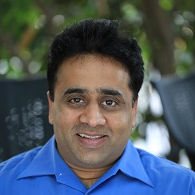
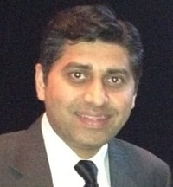
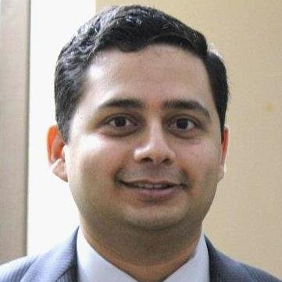


Healthcare Industry : Our team
Mu Sigma has brought together a team of senior industry specialists, to spearhead its efforts in life sciences
Shilpa Bhat
Apprentice Leader
Mahesh Iyer
Healthcare Consultant
Utpal Parekh
Account Manager
Srini Srinivasan
Strategic Advisor
Venkata Venkatakrishnan Engagement Manager
Kadithi Adibabu
Delivery Manager
Amritanshu Kumar Apprentice Leader
9 years of experience in development of biotherapeutics, CMC & development of novel biologics and biosimilars
20+ years of experience in Biostatistics and Biometrics across leading healthcare firms like BMS, Novartis and Boehringer Ingelheim
Currently manages a healthcare innovation consultancy
Management Consultant, Practice Leader in Commercial and R&D domain, and Program Management
20+ years of experience in Life Sciences
30+ years at Pfizer, Novartis, GSK and Astra in global leadership roles
Managed innovative products, vaccines, generics in multiple therapy areas through all stages of development and commercialization
Led teams launching Rx, OTC drugs and Medical Devices in Bayer, Merck
10+ years in Pharma/Med Device, SME - Regulatory Affairs, expertise in creating and executing digital transformation strategies, Software-as-a-Medical Device
13 years of experience in Epidemiology, Market Access & RWE at companies like Novo Nordisk
Leverages RWE evidence to address key outcomes, builds pricing and Health Economics models
10 years experience in Healthcare/Life science Analytics
Setup first India team for HEOR and led the team for HEOR/EPI, data science and data strategy

Slide 65
Executive Summary
Solution Design
Who we are
Engagement & Governance Model
Timelines and Cost
Experience in Promotional Response Modeling and Sales Force Effectiveness
AGENDA

Slide 66






Engagement Model (1/3)
A robust governance model will be put in place for streamlined and effective management of the global delivery team
Steering Committee | The steering committees at both organizations consist of the highest decision makers responsible for setting goals, priorities and monitoring progress They are collectively responsible for the development of the relationship
Swiftwater, PA
USA
Bangalore
INDIA
Engagement Manager | Primary point of contact at Mu Sigma
Regional Head | Highest point of escalation at Mu Sigma and handles critical issues when required
Onsite Associate | Primary point of contact at Mu Sigma. Actively participates in discussions and knowledge transfer
Fulfillment Leader | Manages cross industry accounts and facilitates cross vertical learning
Apprentice Leader | Manages project delivery, communication and adherence to timelines
Decision Scientists | Dedicated extension team
Our Governance Model |  | Governance between? | Artifacts
 | Operational Governance | Apprentice Leader at Mu Sigma and the client’s internal team | WBR, muPDNA, Project Tracker
 | Engagement Governance | Engagement Manager and client PoC | MBR,mu3D, Quality Tracker
We highly respect the client’s data security concerns We connect to the data using VPNs, VMs and Remote Desktop as the data continues to reside in the client environment | How we connect to Data

Slide 67


Engagement Model (2/3)
There is a clear articulation of roles and responsibilities that span a mix of dedicated and shared resources operating in a global delivery model
Dedicated Resources
Shared Resources as part of Mu Sigma Ecosystem
Decision Scientists
AL is responsible for managing project delivery, appropriate communication and adherence to timeline. 4+ years spent in functional analyst roles
100% dedicated to the team of Decision Scientists throughout the engagement
Apprentice Leader (AL)
Dedicated analysts who solve specific problems and deliver analytical solutions to the client
They work at the intersection of understanding the business problem, building statistical models and tests, and delivering visualization tools that can generate actionable insights
10+ years spent in delivery. Handle multiple client teams as a part of a larger portfolio
Guides the teams in aspects of solution design, statistical techniques and overall problem solving
Fulfilment Unit Leader (FU)
The EM works closely with the Onsite Associates allocated to a particular location to ensure alignment in deliverables and outcomes
He/she is responsible for the overall health of the engagement
Engagement Manager (EM)
The Regional Head (RH) is the sponsor on Mu Sigma side – overall responsibility towards maintaining engagement governance. The RH handles critical issues when required and is the highest point of escalation at Mu Sigma
Regional Head (RH)
Onsite Engagement Lead/Associate
DIE is our dedicated innovation and research group with over 100 members. Engaged in prototyping of new technology, products and platforms
Located at onsite premises
Responsible for daily project management, business and scope understanding, collecting client feedback, guiding the offshore teams on deliverables etc.
Delivery Innovation Engine (DIE) (Tech)
The Operational Leadership is responsible for ensuring continuous delivery of quality work at an organization level. They equip each team with all the necessary resources, frameworks and processes
Operational
Leadership
The Client Services India (CSI) acts as a bridge between onsite Client Services and the offshore Fulfillment team. Focused on operational planning and engagement governance
Client Services India (CSI)

Slide 68



Engagement Model (3/3)
Skills & Knowledge: The resources for this engagement bring experience across different roles along with varied skillsets and domain knowledge
DECISION SCIENTIST
(OFFSHORE)
APPRENTICE LEADER
(OFFSHORE)
FULFILLMENT UNIT LEADER
(OFFSHORE)
ENGAGEMENT MANAGER
(ONSITE)
REGIONAL HEAD
(ONSITE)
- Convert business problem to analytical problem and test hypotheses
- Execute Descriptive, Inquisitive and Predictive type of analysis
- Build statistical and ML models
- Develop tools for automation and data visualization
- Project management
- Coaching and mentoring teams
- Solution design for muddy/fuzzy problems
- Ensures that analytics is actionable and enables consumption
- Leverages existing
Mu Sigma expertise & ecosystem
- Leading multiple accounts
- Acts as the guiding hand that provides valuable learning across industries and functions to the off-shore team
- Achieves set goals and ensures quality of the deliverable
- Account management & ensuring customer satisfaction
- Developing engagement roadmaps
- Project management
- Solution design for muddy/fuzzy problems
- Presentations to senior clients
- Responsible for strategic conversations
-Highest point of contact for escalations
-Align multiple stakeholders to a common goal
- Ensure the analytics is actionable and enable consumption of solutions
ROLE
- Advanced database tools & techniques
- Advanced Business Intelligence
- Advanced knowledge of
Statistical/ML tools such as SAS, R or Python
- Advanced knowledge of Statistical tools
- Advanced Business Intelligence tools
- Presentation skills
- Team management and inter-personal skills
- Ability to create analytics roadmap
- Synthesis and Presentation skills
- Team & project management skills
- Ability to apply first principles and create structured approaches to problem solving
- Ability to create analytical roadmap for clients
- Interpersonal and project management skills
- Experienced in analyzing business problems with a keen eye for detail
- Ability to create structured approaches to problem solving and analytics roadmap for clients
- Ability to nurture client relationships
-Relationship and project management
- Crisis management
-Ability to nurture client relationships
-Financial negotiations
SKILLS
- Structured problem solving frameworks
- Deep knowledge of statistical techniques, and ML/AI methods
- Cross-industry experience across a few functions
- In-depth knowledge of applications of analytics for multiple industries
- Structured Problem Solving frameworks
- Deep knowledge of statistical techniques, AI and OR methods
- In-depth knowledge of business functions and applications of analytics
- Structured Problem Solving frameworks
- Deep knowledge of statistical techniques, AI and ML methods
- In-depth knowledge of multiple industries
- Well versed with statistical techniques, database tools & techniques
- In-depth knowledge of 1-2 industry verticals
- Experiences with assisting clients consume various analytical outputs
- Experience with handling accounts across industry verticals
- In depth knowledge of various business domains
KNOWLEDGE

Slide 69
Governance Model
Governance model is designed to create a well knit mechanism for measuring key success factors for the partnership
Theme | Mu Sigma Stakeholder | Client Stakeholder | Forum | Discussion on Success Factors | Artefacts
Delivery Quality & Planning (Weekly) | Delivery Team & Onsite Associate | Project Leads | Weekly Business Review (WBR) | Address the week’s delivery, share feedback and decide corrective actions, if any Align on project priorities for the upcoming week | Weekly project tracker and prioritization tracker
Engagement Health (Monthly) | Account Management Team | Project Leads Program Manager | Monthly Business Review (MBR) | Measure alignment to business priorities and chalk out plans for the next month Ensure documentation during transition and after rationalization/consolidation Capture feedback through a formal process to measure value added and ensure implementation of feedback provided Assess value-add from engagement model | Mu3D document – Mu Sigma’s standard template used across our Fortune 500 customer base to evaluate the engagement and partnership health, and ensure alignment of delivery to customer’s vision EoC artefacts – updated documentation of dashboard specs
Alignment to business goal (Quarterly) | Account Management Team Steering Committee | Project Leads Program Manager Steering Committee | Quarterly Business Review (QBR) | Measurement of partnership objectives - Alignment to business goals and requirements Evangelizing insights and impact of work Access to Mu Sigma learning ecosystem for internal capability building | Decision Supply Chain (DSC) - capture consumption cycle across all projects Success stories (videos, presentation) to socialize insights and impact of work

Slide 70
Executive Summary
Solution Design
Who we are
Engagement & Governance Model
Timelines and Cost
Experience in Promotional Response Modeling and Sales Force Effectiveness
AGENDA

Slide 71
Our milestones
We will deliver the project by end of July with a team of 1 on-site Associate and 6 off-shore Decision Scientists
Dec 2019
Pre-kickoff
Jan 2020
mid-Jan 2020
Project Kick-off
Data Review
mid-Feb 2020
Segmentation
Feb 2020
Promotion Response Modeling
Apr 2020
Sales Force Sizing Simulation
May 2020
Alignment
Jul 2020
People Placement
End of Jul 2020
Project completion

Slide 72



What will it cost? (1/2)
We will deliver the project by end of July with a team of 1 on-site Associate and 6 off-shore Decision Scientists
No reinventing the wheel
Quick turn-around time enabled by existing reproducible components, platforms and experience from working with Fortune 500s
USD 497,147
DURATION
8 months
Training and Evangelization
KT and Handover at the end of project along with training sessions for the team on using the platforms
Roadshows and Workshops
White-box solution
Full accessibility of code & deliverables
Flexibility in scaling to similar business needs

Slide 73
What will it cost? (2/2)
Detailed break-up of the engagement cost is provided below
Mu Sigma Monthly Fees
(per resource)
Resource location | Monthly Fees (USD)
Decision Scientist - Bangalore, India | $8,602
Associate - Swiftwater, PA | $19,409
Engagement Cost
Cost Type | Timeline | Staff Count |  | Monthly Cost | Total Cost (2020)
 |  | Onsite | Offshore
Total Engagement Cost ($) | Dec 01, 2019 – Jul 31, 2020 | 1 | 6 | $71,021 | $568,168
Discount ($) |  |  |  |  | $71,021
Final Engagement Cost ($) |  |  |  |  | $497,147
Note:
Mu Sigma will discount the professional fees for the first month of our engagement (pre-kickoff stage)
Link to Executive Summary

Slide 74
Executive Summary
Solution Design
Who we are
Engagement & Governance Model
Timelines and Cost
Experience in Promotional Response Modeling and Sales Force Effectiveness
AGENDA

Slide 75






We have built capabilities within multiple customer organizations in the promotional response modeling and sales force effectiveness space
PROBLEM SPACE
OBJECTIVE
OUTCOME
Segmentation
Optimize physician targeting by identifying the right set of physicians through segmentation
A 4 step approach was developed to segment physicians based on their responsiveness and behavioural pattern
Enabled customized targeting and messaging for 100,000+ physicians
Leading Pharma Company
Enhance marketing effort by identifying best allocation across products, markets, and marketing programmes across multiple geographies
Recommendations from our marketing mix solution for helped obtain incremental profits of €6M+ for Brand-1 and €5M+ for Brand-2
Promotional Response Modeling
Leading Pharma Company
Estimate Salesforce for a product to be launched in the market
Developed an Agent based modelling solution which was capable of testing multiple scenarios by changing the salesforce sizing and obtain the optimum result
Forecasted sales performance of the drug for a subsequent
3 year period for different scenarios of salesforce sizes
Sales Force Sizing
Top Pharma Company
Territory Alignment
Analyze balance, fairness and effectiveness of territory alignment
Led to clubbing of territories, removal of vacant or whitespace territories, reduction of territory imbalance
Led to clubbing of territories, reduction of vacant/whitespace territories, and reduction of territory imbalance
Top Pharma Company
People Placement
Optimal assignment of Sales personnel to maximize performance rating & ensuring business continuity
Multiple scenarios was created and modelled to arrive at the final solution
Annual operational cost saving of $4.5Mn
Top Pharma Company

Slide 76
APENDIX

Slide 77





Vaccine Industry is a complex network
Creating an effective solution for a business problem requires an effective understanding of the various interactions between the entities
World Health Organization
Recommendations
National Medical Societies
Recommendations
National Technical Advisory Groups
Donors
(e.g. GAVI)
Public Authority: Purchase and Funding
Recommendations
National procurement agencies
(e.g. CDC)
International procurement agencies
(UNICEF, PAHO)
Private Insurance
Vaccination Mandates
Reimbursement
Reimbursement
Prescription, delivery, administration
Physician
Hospitals
Out of pocket payment
Consumers
Prescribers

Slide 78

Designed intelligent DQM utility will lead to quality data, improved business confidence and decision making
Illustrative
Multiple Sources
Automated Data Quality Process
Transformation & Data Collation
Failure Log
Completeness Check
Expected volume of entries
Failure
Log
Alert Source Owner
Data Discrepancy
Master Data
Uniqueness Check
Data duplication
Primary key evaluation
Failure
Log
Business Rules
Data Discrepancy
Data Collation
Data Type Consistency
Data Type
Length of data field
Failure
Log
Data Discrepancy
Sample Business Rules
Sales greater than 0
Value share between 0% and 100%
% Volume on promotion between 0% and 100%
Market Spend greater than $0
Structured Data
Accuracy Check
Business Rules
Failure
Log
Data Discrepancy

Slide 79
Segmentation (1/3)
Mu Sigma helped a leading pharma company to identify right set of physicians to be targeted for its newly launched drug
Background
Analytical approach
Client is one of the largest pharmaceutical firms in US and has recently launched a drug in the diabetic market
Client has set-up various marketing activities such as drug detailing, sampling, speaker programs etc., to promote the drug
Client wants to identify the right set of physicians to be targeted through these marketing activities
A 4 step approach was developed to identify the potential prescribers
Identification of the physician universe for the drug
Hypothesis generation and variable creation using analog drug information
Objectives
The key objectives of the exercise were
Develop a model that can identify the profitable physicians for various marketing campaigns
Achieve higher ROI by targeting the identified physicians
Segmentation of the physicians based on their responsiveness to promotions and behavioral pattern
Customization of the target list based on the certain business rules, call plan, territory alignment, etc.,
Back to Index

Slide 80
Segmentation (2/3)
A robust analytical framework was developed to identify target physicians based on their responsiveness and behavioral patterns
Analytical Framework
Market Potential
Current Value
Managed care influence
Switching tendency of patients
Adoption of new products
Share of various sales channels
Competitor share
Specialty
Branded to Generic ratio
Response to promotion
Analytical Translation & Methodology
V
A
R
I
A
B
L
E
S
C
O
N
S
I
D
E
R
E
D
Variable Creation and Treatment
List of variables is built from perspective of objective behind segmentation
Base list Preparation
The base list of physicians to be considered for segmentation consist of all the physicians who have prescriber in Market in the last two years (But this definition is very much dependent on Brand and objectives of segmentation)
Segmentation Analysis
A model based clustering analysis was performed on the Base list of physicians based on their responsiveness to promotions of the analog and behavioral pattern
The following primary treatments is performed on the variables created to get better understanding of variables
Univariate ,Correlation
Outlier and Missing values Treatment
Narrowed down the variable list by running a factor analysis
Segmented physicians were customized based on the client needs and geographical alignment of the sales representatives
Back to Index

Slide 81
Segmentation (3/3)
Based on value, influence, prescribing uniformity and other key attributes, five unique segments were identified
Managed Care
Complacent
Loyalists
Diabetes Gurus
Early Adopters
Low Writers
Med Writers
Low Adoption
60,100 physicians cover 26% of Select Injectable TRx and 25% of Product TRx
Two-thirds of the physicians have low responsiveness towards Product promotions
Low Adoption to new products
4% HCPs of ENDOs are covered in this segment
No Preference
High Writers
Med Adoption
23,100 physicians cover 10% of Select Injectable TRx and 15% of Product TRx
Two-thirds of the physicians have medium responsiveness towards Product promotions
Medium Adoption to new products
15% HCPs of ENDOs are covered in this segment
Very High Product preference to Competitor product
High Writers
High Adoption
24,700 physicians cover 52% of Select Injectable TRx and 49% of Product TRx
50% of the physicians have high responsiveness towards Product promotions
High Adoption to new products
68% HCPs of ENDOs are covered in this segment
High Product preference to Competitor product
Med Writers
High Adoption
4,600 physicians cover 5% of Select Injectable TRx and 4% of Product TRx
Half of the physicians have medium responsiveness towards Product promotions
Very High Adoption to new products
11% HCPs of ENDOs are covered in this segment
High Product preference to Competitor product
Low Writers
Low Adoption
30,100 physicians cover 7% of Select Injectable TRx and 6% of Product TRx
Almost all of the physicians have low responsiveness towards Product promotions
Very Low Adoption to new products
2% HCPs of ENDOs are covered in this segment
Low Product preference to Competitor product
Back to Index

Slide 82
Promotional Response Modelling (1/8)
Mu Sigma is partnering with the Data Sciences and Analytics (DSA) team to deliver 9 MMx projects across 7 non-US markets, in addition to other test-control, dashboarding and ad-hoc analysis projects
Larger objective is to scale marketing mix models globally i.e. 30 markets across 18 geographies and enable local teams to run MMx projects independently
U.K
Brand 1 MMx
Germany
Brand 1 MMx Brand 2 T/C GRNP Analysis
France
Brand 1 MMx Brand 2 MMX DME Analysis
UK
Turkey
Brand 1 MMx
Germany
France
Turkey
Japan
China
Japan
Brand 1 MMx Brand 2 MMx
Brazil
Brand 1 MMx
Brazil
China
M3 Dashboard M3 T/C
Back to Index

Slide 83
Promotional Response Modelling (2/8)
Mu Sigma recommended a “modular approach” of implementation to scale the Marketing Mix Modeling across markets
RECOMMENDED
Ad-hoc
Product
Modular
VS
VS
Advantages
High flexibility to customize to each brand country combination
Can choose to minimize documentation overheads
Almost “plug and play” allowing for rapid use
UI based approach makes it very easy for end users
Flexible to accommodate nuances while scaling across markets
Relatively loosely-coupled building blocks will enable any changes faster
Disadvantages
Not Scalable
Manual in nature, Highly error prone
Limited functionality
Limited customization
Biased towards workflows guided by statistical inference as compared to business intuition
Will have an initial learning curve
Low Scalability
Scalable
Not Flexible
Scalable &
Flexible
Back to Index

Slide 84


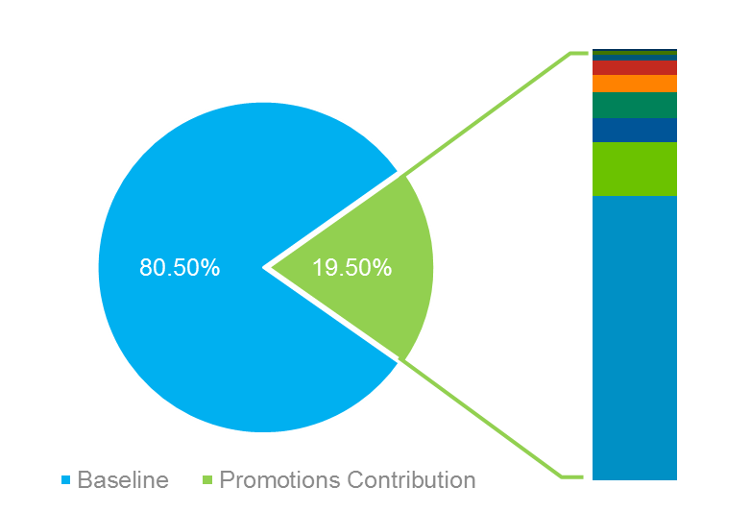










Promotional Response Modelling (3/8)
A robust solution framework is being established in order to ensure high quality reproducible outcomes which will enable us to scale quickly
Business Team
Analyst Team
Benefits to Client
Consumption
Optimization tool using RShiny
Interactive Dashboard using Tableau
Slide library
Hypothesis Library
EDA Report
Outliers Report
QC Report
Publishing the final results of analysis in a business-ready and consumable format
MMx Modeling
Notebook
Iteration Manager
ADS Notebook
Optimization module to give customized results based on specific model form instead of standard custom functions
Model Building
Batch Processing System
EDA Brick
Data processing & integration to create the final ADS for modelling
QC Brick
MMx notebook to significantly accelerate modeling phase, and ensure that exhaustive set of iterations are tried out
BPM
End-to-End Automation
Data Processing
Flat files
Database/Data Warehouse
Data on Cloud
ADS notebooks with modularized codes increase reusability across markets, and easily assimilate business rule changes
Data Collection
Budget file
Sales Data
Activity Data
Quickly gain high confidence on raw data, and identify anomalies, through the BRD, and the EDA and QC bricks
Spends data
Mapping files
Back to Index

Slide 85








Promotional Response Modelling (4/8)
Starting in August last year, we are on our way to successfully execute marketing mix projects across four Must-Win markets for Brand I
France
Brazil
Japan
Germany
(Completed - Nov’17)
(Completed - Mar’18)
(Expected Completion - Jun’18)
(Expected Completion - Jun’18)
Detailing
Events: Local,Congress,Cascading,Standalone
Digital: YouTube,Twitter,Webcast,Website
Detailing
BPV
Events:
Sponsorship
Digital:
Website and Email Newsletter
Detailing
Events:
Local events and Congress
Digital:
Webinar and SDeD
Detailing
Events:
Local,Cooperation,Sponsoring,Congress,CME
Digital:
Infocenter and Webcast
Detailing
Events
Digital
Detailing
Events
Digital
France
Brazil
Japan
Germany
Back to Index

Slide 86





Promotional Response Modelling (5/8)
Impact | Commercial – Brand I
Recommendations from our marketing mix projects for Brand-1, across France, Japan & Brazil can help obtain incremental profits of €6M+
France
€1.3M to €1.5M
Increase in Profit*
Japan
€3.7M
Increase in Profit*
Detailing budget
Reduce budget or reallocate across regions
No optimization carried out
Profits based on regional response curves
Increase overlap of event attendees with detailing targets
National Budget
Fixed
Other channels budget
Vary ±20% at channel level
Reallocation across clusters (vary ±20%)
Brazil
€425K
Increase in Profit*
Detailing budget
Fixed at National level;
Reallocation across clusters (vary ±20%)
LB for Value segments 12-20 fixed & UB as +20%
Continue the retargeting carried out in Detailing, which is performing well with ROI increasing from 1% in 2017 to 12% in 2018, and 13% in 2019
National Budget
Fixed
Other channels budget
Fixed
Overall, reallocate spends from Congress and Webinars to Local Events and SDeD
Detailing budget
Fixed at National level;
Reallocation across districts
Reduce spends on Bronze and Non Potential segments and reallocate to higher value segments
Identify opportunities to do multiple targeting & continue providing calls in both hospital and office based setting
Recommend a cap on maximum monetary discount availed per patient
*These are the quantified incremental profits obtained by recommended resource re-allocation. Further application of recommendations will realize higher returns
Back to Index

Slide 87

Promotional Response Modelling (6/8)
Impact | Commercial – Brand II
Recommendations from our marketing mix projects for Brand-2, across France & Japan can help obtain incremental profits of €5M+
France
€0.7M
Increase in Profit*
Japan
€4.4M
Increase in Profit*
National Budget
Vary ±5%
Regional Budget
Vary from 0 to overall maximum budget
Detailing budget
Vary ±10%
Other channels budget
Local Events - Vary ±10%
EYExchange - Vary ±20%
Email Newsletter - Vary ±20%
Congress & EYExpert - Fixed
National Budget
Fixed
Other channels budget
Vary ±20% at region - channel level
Detailing budget
Fixed at National level;
Reallocation across regions/segments
Reduce calls to specialists other than Ophtha (including Orthoptists) and reallocate calls to Hospital Ophthalmologists
Reduce Local Events spend by JPY 2.5M and reallocate it to other channels, to observe an overall ROI increase of 38%
On detailing channels, keep optimizing number of calls and improving target coverage (reduce non-target calls) to sustain high ROI
Reduce detailing spends on regions of feeble responders and reallocate it to high potential regions like Tokyo and Tokai
*These are the quantified incremental profits obtained by recommended resource re-allocation. Further application of recommendations will realize higher returns
Back to Index

Slide 88





Promotional Response Modelling (7/8)
Learnings from one market can be leveraged across other markets to improve execution of promotional channels
Detailing
Events
Digital
Client organized, highly targeted events yield better returns than larger Congress events
EYExpert (France), GRNP (Europe & Asia), Forum Oculus (Germany) events are good examples
Improve attendee data coverage with consent information, to aid analyses
Better data capture will aid further analyses, which in turn will help yield more valuable insights
Leverage Events – Detailing cross-synergy
Increasing overlap of event attendees with detailing targets has helped increase events ROI in France
Bridge the gap between planned vs actual spends on digital channels
The actual spends on digital platforms is a fraction of the planned budget
Consistently better performance of the digital channels in yielding ROI across countries, highlights the urgency of taking steps in this direction
Monitor digital channels in a consistent fashion
Leverage a standard KPI framework
Keep an eye on cost/engagement
Reduce disconnect between digital platforms
Improve call plan adherence
Reduce calls provided to non-targets
In Japan Brand 2, improving the total call share of targets by 9% in one of the cluster increased the ROI by 96%
Measure sales force responsiveness at the most granular level possible*
This helped in realizing highest possible incremental profits, by reallocating visits based on responsiveness of accounts, to improve detailing impact in Japan
*This recommendation is observed from Brand 1 analysis
Back to Index

Slide 89
Promotional Response Modelling (8/8)
Impact | Technology
We have executed multiple projects using the 2-step MMx methodology and enriched it further using advanced techniques through a continuous learning approach
Enriched 2-Step Models
Challenges faced across markets
Developed multiple transformation techniques on strong foundation of reproducible research
Linear-Linear
Log-Log
Linear-Log
Sporadic investment in channels
Multi- collinearity
Time Trend Variable
Dummy Variable
Interaction Variable
Lack of stable baseline
Implemented multiple modeling techniques to substantiate beta estimates and reflect confidence around them
Partial Least Squares
Multivariate Additive Regression Splines (MARS)
Ordinary Least Squares (OLS)
We anticipate these to recur as we scale, and have explored and built capability to tackle them
Mixed Effects (LME)
Generalized Additive Model (GAM)
Bayesian Hierarchical Model
Back to Index

Slide 90








A pharmaceutical client wanted to estimate the salesforce size required for marketing a newly launched product
Sales Force Sizing (1/3)
A large pharmaceutical client wants to estimate the salesforce required for marketing a newly launched product
Limited data is available for the newly launched product for use in traditional approaches for a long term strategy
Payer constraints and non-linearity in the behavior forces us to consider other approaches to solve the problem
The new approach to solve this problem takes into consideration interactions between the different entities that play a significant role in deciding the success of a product
Identify key characteristics of the agents
These characteristics define the agents and provides the direction for the model
Define simple rules to model the system
Layout the rules that will decide the outcome of the interactions
Define the constraints
These rules will make sure that the system is bound
Patient attributes
Sales Rep attributes
Location (Health referral region)
Sales team
LDL cholesterol level
Specialty segment of current physician
Performance on territory
Location
Payer coverage
Current treatment
Perform Agent based modeling for important agents identified to be the drivers of sales
Identify the key characteristics for the agents and define simple rules to model the system
Run various scenarios by changing the salesforce sizing and obtain the optimum result
PDE attainment
Physician attributes
Location
Physician segment
Patient volume
Willingness to prescribe
Specialty
Back to Index

Slide 91








Simulation model helps predict likelihood of physician prescribing the drug and patient adopting it
Sales Force Sizing (2/3)
Sales Rep, Physician and Patient work flow
Output
Patients
Physician prescribes 'Drug X' based on the probabilities associated with current Treatment + LDL level of the patient
Physician shifts Patients’ Treatment based on his current Treatment-LDL level and national movement of patients – based on data
Physician
Physician will make a choice:
Keep patients on current Treatment
Make changes to non-Treatment concerned products
Prescribe 'Drug X‘
Prescribe Competitor ‘Drug Y'
Patient decision making is unique based on his characteristics
Physician decision making is unique based on his characteristics and influence of the sales rep
Insurance Eligibility
Determined by utilization management criteria
'Drug X' or 'Competitor Drug Y' Dispensed
Rep visit changes:
Physicians’ likelihood to use Treatment concerned
Choice between 'Drug X' and 'Competitor Drug Y'
Location
Sales Rep
Business assumptions
All interactions happen within the geographic boundaries (HRRs)
Each rep can give a maximum number of sales calls (based on historical data)
Every physician has a cap on the number of patients he can in a month based on the historical data
Patients interact with physicians each month (2/3rds return to same doctor and 1/3 visit different physician)
Back to Index

Slide 92
Recommendations from the agent based model helped the client optimize their salesforce size to achieve sales targets
Sales Force Sizing (3/3)
Results
Mu sigma forecasted the sales performance of the drug for the next 3 years for different scenarios of salesforce sizes
Business Impact
The clients could estimate the optimum salesforce size to achieve the sales targets
Back to Index

Slide 93
A leading Pharmaceutical company needs to understand the fairness, balance and effectiveness of the territory alignment for its new product launch
Territory Alignment (1/8)
Situation
To support a new product launch, a sales force strategy (targeting, sizing, territory alignment) has been crafted
However, a sales team size considerably less in number than the original recommendation has been decided to be used
The sales process has 4 primary stages, i.e. Lead Generation => ID Champions => On P&T Agenda => On Formulary. Targeting the right champions has highest impact on sales
Key questions
How to best reallocate reps to territories to cover “whitespace”?
Is the current territory alignment imbalanced or unfair?
How can you optimize the allocation to minimize travel & unmet potential ?
Complications
This has led to:-
clubbing of territories
whitespace or vacant territories
Less than ideal coverage of targets
Because of practical constraints due to large travel distances, the coverage of high potential accounts may not be high
Back to Index

Slide 94
A hub & spoke distribution model is most suitable to simplify coverage of the network of hospital accounts
Territory Alignment (2/8)
Approach (E.g. 631B)
Simplify Coverage path
Understand driving distances between hospital accounts
Cluster hospital accounts together to maximize inter-cluster distance while minimizing intra-cluster distances
Identify “hubs” of potential amongst clusters
Identify shortest paths between hubs
Optimize clusters
Within each cluster, find the shortest path to cover maximum potential with minimim travel distance
12/14/2019
Back to Index

Slide 95
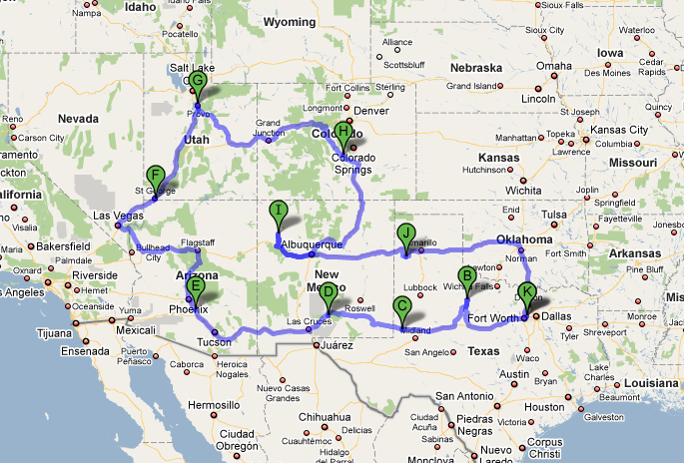
Territory 631B can be broken down into 10 hubs with varying potential
Territory Alignment (3/8)
Hub | City | Potential | Miles
A | Richland Hills | 20,535 | 0
B | Knox City | 4,595 | 239
C | Andrews | 11,388 | 227
D | Alamogordo | 12,250 | 237
E | Sacaton | 31,708 | 427
F | St. George | 3,332 | 546
G | Vineyard | 13,577 | 271
H | Canon City | 7,789 | 521
I | Crownpoint | 10,732 | 525
J | Hereford | 6,777 | 402
K | Richland Hills | 0 | 514
Total |  | 122,683 | 3909
12/14/2019
Back to Index

Slide 96
Within each cluster, the hospital accounts can be covered with varying levels of efficiency
Territory Alignment (4/8)
Most Efficient Frontier
By traversing the hospitals through the shortest path, the maximum potential can be covered with minimum distance
Following the “shortest path” algorithm, major portion of the potential can be covered with significantly less travel distance
The efficiency realized on the ground will lie somewhere in this region, based on practical constraints
Least Efficient Frontier
By traversing the hospitals through the longest path, a lot of travel will be required to cover the entire potential
Because of the wrong choice of sequence of hospital accounts visited, substantially lower potential can be covered with relatively high travel distances
12/14/2019
Back to Index

Slide 97
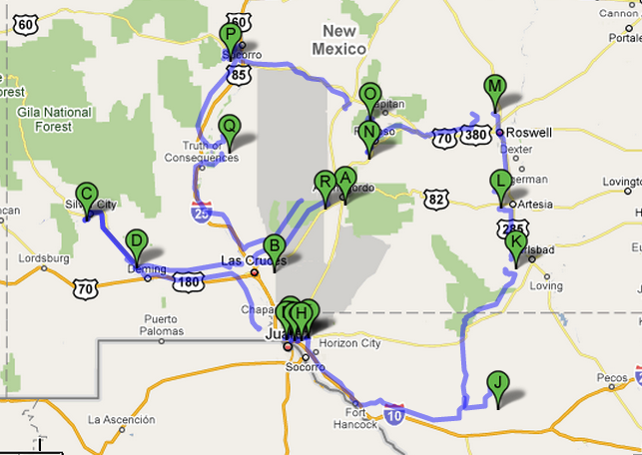
The full potential of Almogordo cluster (i.e. 12251) within 631B can be covered in 1300 miles…
Territory Alignment (5/8)
Node | City | Potential | Miles
A | Alamogordo | 420 | 0
B | Las Cruces | 1439 | 81
C | Silver City | 156 | 133
D | Deming | 1383 | 60
E | ElPaso | 448 | 110
F | El Paso | 55 | 5
G | El Paso | 1331 | 6
H | El Paso | 4713 | 5
I | El Paso | 106 | 7
J | Kent | 106 | 144
K | Carlsbad | 488 | 147
L | Artesia | 64 | 50
M | Roswel | 0 | 64
N | Mescalero | 528 | 94
O | Ruidoso | 673 | 36
P | Socorro | 54 | 110
Q | Cuchilo | 288 | 101
R | Almogordo | N.A | 145
Total |  | 12251 | 1298
12/14/2019
Back to Index

Slide 98
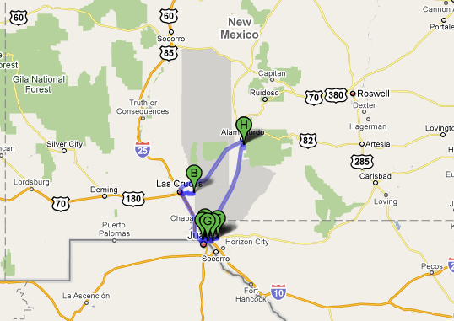
…or a limited set of hospitals representing 81% of the potential can be covered in only 25% of the distance
Territory Alignment (6/8)
Node | City | Potential | Miles
A | Alamogordo | 420 | 0
B | Las Cruces | 1439 | 81
C | El Paso | 4713 | 51
D | El Paso | 447 | 5
E | El Paso | 155 | 13
F | El Paso | 1383 | 6
G | El Paso | 1331 | 6
H | Alamogordo | N.A | 85
Total |  | 9888 | 247
12/14/2019
Back to Index

Slide 99

Zip code allocations were optimized to maximize potential from reached accounts subject to constraints on driving distance
Territory Alignment (7/8)
Optimization
Target List per Rep
Map distances
Scenario Modeling
Target list per Rep
Optimized
Sales Territory Deployment
Rep A – Account A
Rep B – Account B
Rep C – Account C
…etc
Potential
Base case
Driving Distance
Approach & Deliverables
Determine driving distances between the different zip codes
Driving distance will be measured from a “centroid” - which is the territory address
Optimize the allocation of zip codes to territories to maximize potential reached, subject to constraints on:
Maximum travel distance/rep
Account potential
Available capacity
Understand the implications of different allocations on key dimensions:
Minimize untapped potential
Create target list @ territory level that will optimize the travel distances
12/14/2019
©2009 Mu Sigma Inc.
Back to Index

Slide 100
Whitespace zip codes were mapped to territories considering driving distance only
Territory Alignment (8/8)
Squares – whitespace zips
12/14/2019
©2009 Mu Sigma Inc.
Back to Index

Slide 101
Sales Personnel Placement Framework (1/3)
Mu Sigma helped a leading pharma client in a major sales force optimization and deployment initiative engagements
Background
Objectives
Client is among the top five drug manufacturers in US with over 4,000 sales personnel detailing blockbuster products
They want to restructure and downsize 7 sales teams owing to patent loss of one of its blockbuster drug
They want to retain best performers and optimally place them ensuring minimal disruption and maximum business continuity
To maximize performance rating at a national level
To determine all the sales professionals who need to be let go based on the availability of positions
To ensure minimal disruption post restructuring while maximizing business continuity
Analytical Approach
A well-defined stepwise process is followed for placement projects enabling effective execution and pro-active communication
Finalize Territory Alignments
Define placement rules & criterions
Design assignment algorithm
Generate Scenarios & Diagnostics
Final results and field communication
Design territory alignments based on common objectives:
Balance Workload
Balance Potential
Maximize Coverage
Minimize Travel
Define candidate eligibility and prioritization criterions:
Distance
Pay scale
Performance
Tenure
Business Continuity
Design process flows and assignment algorithm
Maximum placements
Best fit placements
Multiple scenarios with diagnostics are created in line with business objectives. Best scenario which meets the business objective is selected
Final placements results shared with business and HR/Legal & extended placements options are provided for displaced SPs, if required
Back to Index

Slide 102
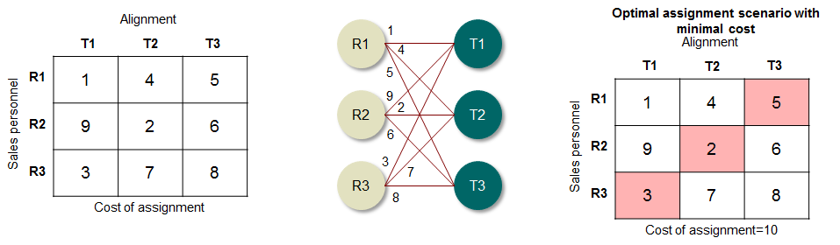
Sales Personnel Placement Framework (2/3)
An optimization algorithm is developed to optimally assign sales personnel to geographies in line with business objectives
Analytical Framework
Multiple criteria & factors are considered at various levels of personnel assignment
Based on the business objective, candidate eligibility criterion and priority of tie-breaking rules are defined
‘Hungarian algorithm’, an assignment optimization algorithm is developed to optimize the placement of sales personnel across various positions
Distance of personnel from working geography
Personnel live-in criteria
Business/ Customer continuity
Tenure
Performance rating
Segment breadth/ experience
Travel time to geography
A cost matrix is populated based on the cost associated with each assignment, i.e. Sales Personnel and alignment combinations
Each assignment is evaluated across all the parameters and a rank is assigned to each
The rank is fed as an input to the algorithm, which reduces the overall cost of assignment
The resultant solution is maximum no. of assignments and minimal cost
Back to Index

Slide 103
Sales Personnel Placement Framework (3/3)
Optimal assignment of sales personnel helped retain talent ensuing minimal disruption and maximizing business continuity
Analysis & Results
Key Findings & Insights
Multiple scenarios were evaluated and the final result had the best placement by performance rating, optimal travel efficiency and ensured maximum business continuity
Approx. 90% of the available positions were occupied with an average performance rating of 3.8 out of 5
Above 300 Sales reps and district sales managers were displaced and were provided severance packages
Illustration
Business Impact
Optimization algorithm mitigated the number of displaced reps by about 90 sales personnel, an approx. cost saving of about $4.5 MM in operational costs
Client was able to maximize retention of home talent while ensuring high business continuity
Client has a scalable framework for sales personnel placements to implement for any future sales force deployment strategy changes
Illustration
Back to Index

